Slide 1
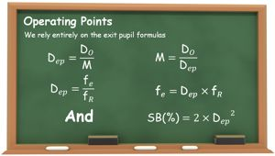
Telescope Examples
How to Size Up and
Set Up a Scope
Randy Culp
Notes:
The telescope equations as presented here are quite simple, so it's entirely possible to analyze a scope, at least to reasonable estimates, in your head -- while at the scope. It's useful to follow a consistent process, and as described here the process goes in two steps, looking first at intrinsic properties of the scope, then setting its operating points.

Slide 2
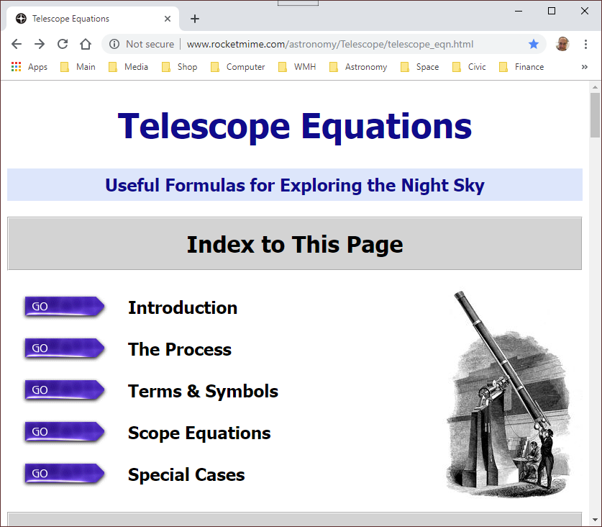
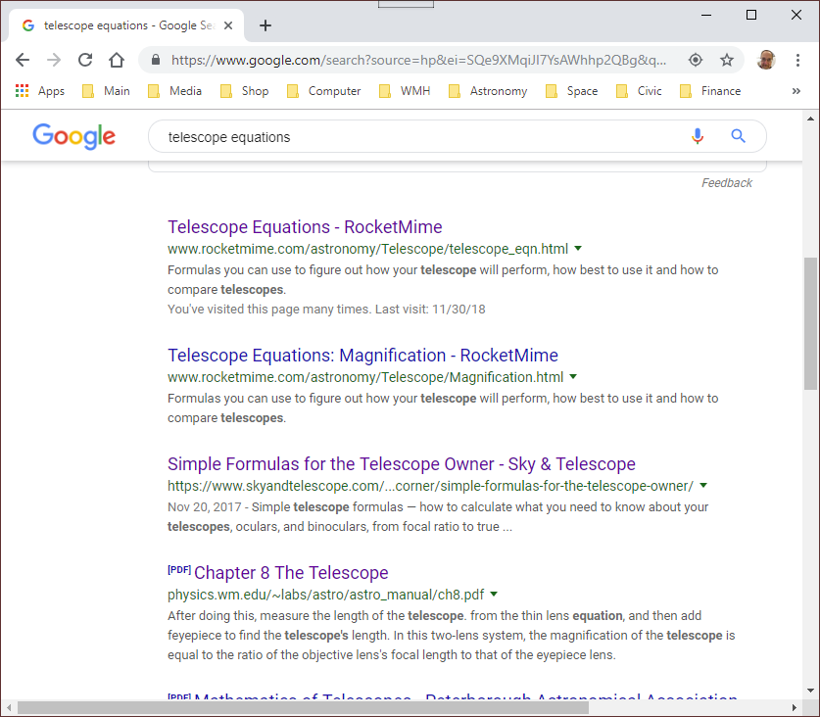
Telescope Equations
Where do these equations come from?
  http://www.rocketmime.com/astronomy/Telescope/telescope_eqn.html

Slide 3

Theory Review

Slide 4
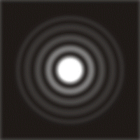
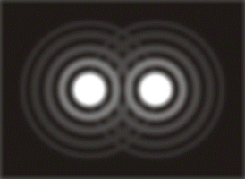
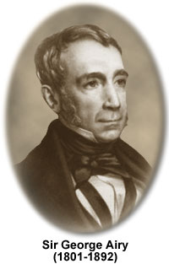
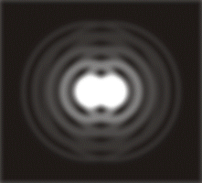
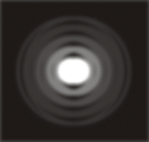
Theory: Airy Disk
Airy Disk
Diffraction Rings
When stars
are closer
than radius
of Airy disk,
cannot
separate
Notes:
If you magnify a star image enough, you will see
the telescope doesn’t actually produce a point but rather
an Airy disk, with diffraction rings (named after Sir George Airy, who described the physics & math behind why you get them)
This is caused by the diffraction of light waves off the edge of the telescope.
The larger the telescope diameter, the more area you have without edges, and the smaller the diffraction effect.
That means two stars can get closer without being mashed together.
==================================================================================
Light travels in waves, and if you’ve ever seen waves go through an opening, like water waves going between rocks, they bounce off the sides and bang into each other in the middle. That’s what happens to light when it passes through the lens of your telescope... it bounces off the sides and bangs into itself in the middle.
The result is that when I go to focus the light to a point, I don’t get a point... rather, I get a disk at the center, with a series of alternating dark and light concentric rings progressing away from the disk.
(You can really see this in a small scope, looking at a bright star under a good sky if the scope has good optics and is well-aligned.)
This effect was described and calculated by Sir George Airy in 1834, so it’s called the “Airy Disk”, after Sir George. He showed the size of the disk goes inversely with the aperture – the diameter of the objective, D_{O}. The rings are often called “diffraction rings”.
My ability to tell the two stars apart depends on the size of the Airy disk, and
the size of the Airy disk in turn depends on the diameter of the telescope.
Therefore, my ability to distinguish two close stars depends on the scope diameter.
If I can make the size of the Airy disk smaller, by making the diameter of the scope larger, I can separate stars that are closer.
============================================
So now in the case of your telescope the circular opening of the telescope creates a circular interference pattern.
Because of this interference pattern, when you make an image of a star, it does NOT focus to a perfect point. Rather, it focuses to a disk, and if you set your telescope for high magnification and examine the image carefully, you can see that there is a disk with faint rings around it -- this is the interference pattern that is caused by the circular aperture of your telescope. In fact, this is a special interference pattern and it has a special name -- the "Airy disk" -- named after Sir George Biddell Airy, an English astronomer who described this pattern mathematically in 1834.
The top left is my drawing of an idealized picture of an Airy disk. Then the top right is a drawing of two close stars appearing as two Airy disks.
In the bottom left you see the two stars getting as close together as the radius of the Airy disk, and we start to have trouble telling them apart.
So then in the bottom right you see that when the two stars are closer together than the radius of the Airy disk, we can no longer tell them apart.

Slide 5
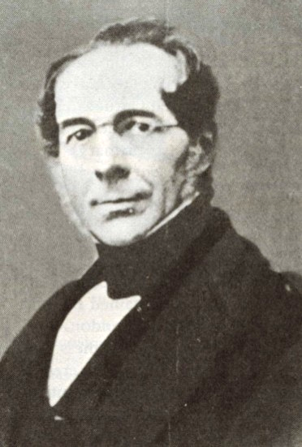
Theory: Dawes Limit
Practical limit on resolving power of a scope:
115.8
Dawes Limit:
P_{R} =
D_{O}
...and since 4 decimal places is way too precise...
120
William R. Dawes
(1799-1868)
P_{R} =
D_{O}
P_{R} is in arc-seconds, with D_{O} in mm
Notes:
The formula we will use is based on the “Dawes Limit”.
William Dawes was a contemporary of George Airy and an astronomer who earned the nickname “Eagle Eye”.
Based on practical experience he defined a limit on the separation of two stars that could be resolved by a good observer under good conditions, and this has become known as the “Dawes Limit”.
Consistent with Airy’s findings, this limit depends on the diameter of the scope you’re working with.
I round it to 120 for two reasons: it’s easier to work with, and it will emphasize a very useful coincidence later on.
================================================
The bending of light which causes this interference pattern is known as "diffraction", and the Airy disk is also known as the diffraction pattern of the scope.
The radius of the central disk of this pattern, in radians -- let's call it "R" -- is given by R=1.22λ/D_{O}, where λ is the wavelength of light, which happens to be 550x10⁻⁹m for green light, and D_{O} is the diameter of the objective in meters (for this formula).
With regard to your telescope, what is important in this equation is that the size of the Airy disk depends on the diameter of the objective ONLY, and as the diameter of the objective gets bigger, the Airy disk gets smaller.
This means as the diameter of your scope gets bigger, you can see smaller and smaller detail -- or equivalently, you can split stars that are closer together. Conversely, this means that there is a limit to the detail you can see with your scope. That limit is dictated ENTIRELY by the diameter of the scope, and it is due to the diffraction effects caused by the scope opening.
For this reason, the radius of the Airy disk, as calculated above, is known as the "diffraction limit".
The diffraction limit equation gives an answer in radians, whereas most dimensions in astronomy are given in degrees, minutes, or seconds of arc. Also because of various other factors, the actual limit of detail that an observer can see does not match exactly to the diffraction limit. Interestingly, a skilled observer can do better than the diffraction formula would suggest.
In 1867, William Rutter Dawes determined the practical limit on resolving power for a telescope, known as the Dawes limit. Dawes expressed this as the closest that two stars could be together in the sky and still be seen as two stars. The Dawes Limit is 4.56 seconds of arc, divided by the telescope aperture in inches. We can multiply the Dawes limit by 25.4 to convert to the metric system (in mm), which gets you to 115.8, and then round to a number that is more convenient when doing the math in your head , and we get the resolving power of the scope, P_{R} as 120/D_{O}.
Note that rounding is perfectly ok since these calculations are not so precise as they look - what an observer can resolve depends, after all, on the observer. These limits represent what a really good observer can do under really good conditions.

Slide 6
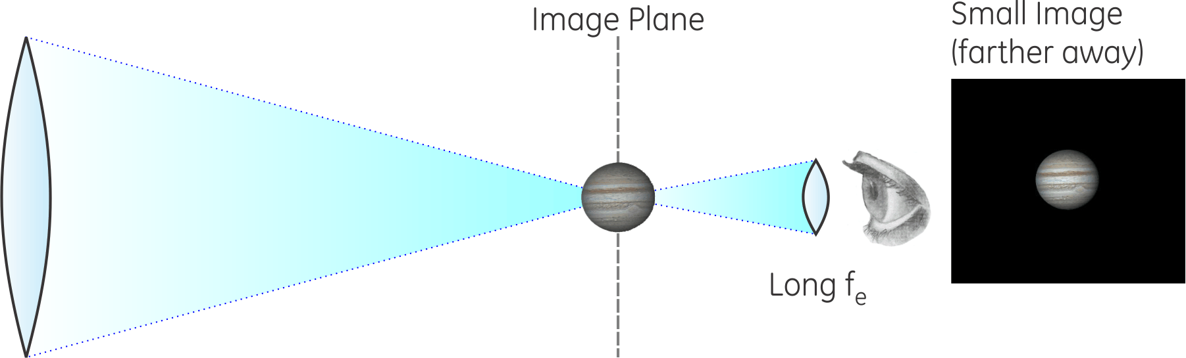
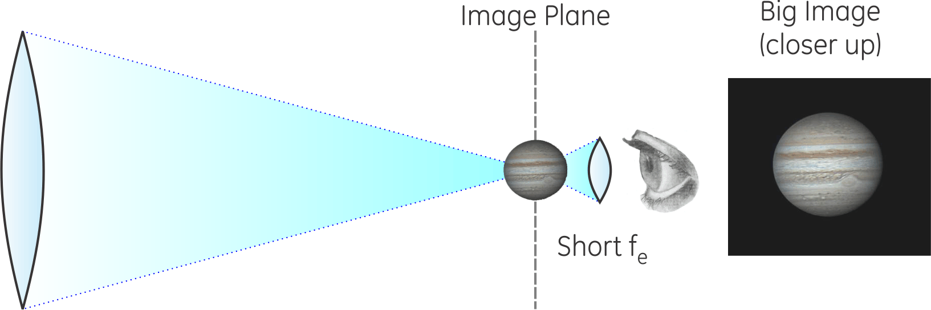

Theory: Magnification
Eyepiece Controls Magnification
Objective
f_{O}
f_{e}
Eyepiece
$$\text{M}= \frac{{\text{f}}_{O}}{{\text{f}}_{e}}$$
Objective
Eyepiece
Notes:
What a telescope does to magnify the images is actually quite simple and intuitive.
The objective lens brings the image to a focus at its focal length, f_{O}.
At that distance, the image looks the same as it does to your eye, that is, distance angles between stars are exactly the same as you see them when you look up.
If two stars are one degree apart in the sky, they will be one degree apart at the image plane, as seen from the objective.
Then the eyepiece, with a much shorter focal length, f_{e}, lets you get very close to that image to look at it, and -- surprise -- when you get closer, the image is bigger.
If the eyepiece lets you get twice as close, the image is twice as big.
If the eyepiece lets you get 50 times closer, then the image is 50 times as big.
The focal length of the objective is a fundamental property of the telescope.
We can control and change the eyepiece we are using. So the magnification of the telescope is determined by the focal length of the eyepiece we choose.
This is important: long f_{e} eyepiece sets me back farther from the image plane – smaller image; short f_{e} brings me close to the image plane – bigger image
Notice also when I get back farther away from the image I can see more of the sky, when I get closer in I’m seeing a smaller part of the sky.

Slide 7
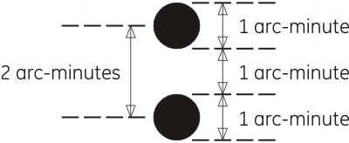
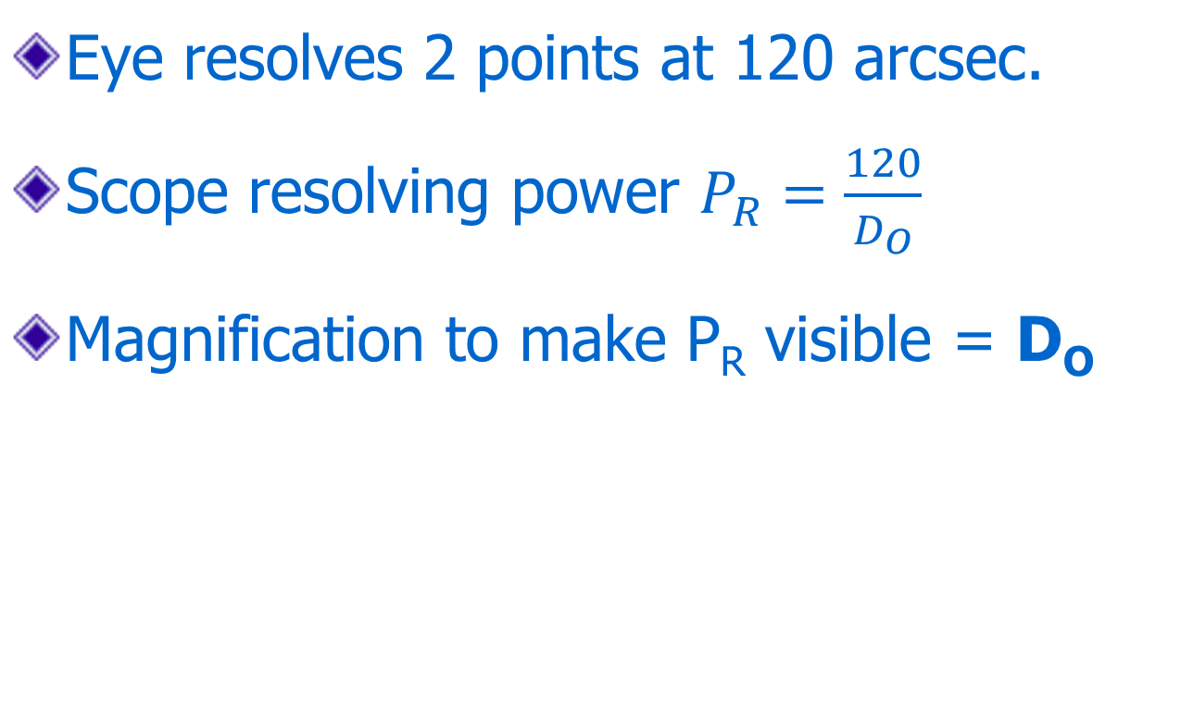
Theory: Max Magnification
Eye resolves 2 points at 120 arcsec.
Scope resolving power $P_{R}=\frac{120}{D_{O}}$
Magnification to make P_{R} visible = D_{O}
Notes:
The lines in the “E” on a doctor’s office eye chart are 1 arcminute thick with 1 arcminute gaps (on the 20/20 line).
So almost by definition, someone with 20/20 vision can just discern two points that are 2 arcminutes apart.
The Dawes limit, the smallest star separation that a scope can resolve, is 120/D_{O} with scope diameter in millimeters.
That means we multiply the resolving power of the scope by D_{O} to raise it to 120 arcseconds, where a 20/20 eye can see it.
You can magnify more than this, but you will see no more detail.
And then secondly... as you magnify further there’s another effect...

Slide 8
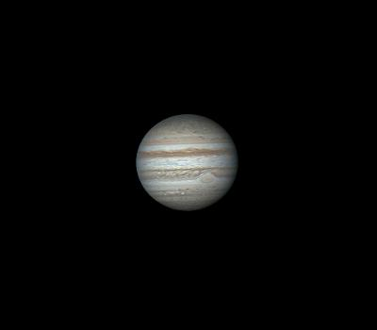
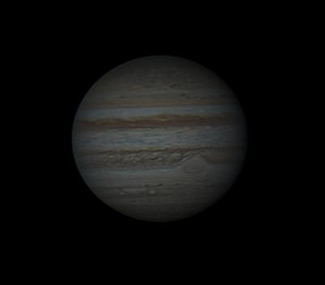
Theory: Surface Brightness
Low Magnification
High Magnification
Notes:
Surface brightness changes with magnification. As I increase magnification I pay a price in brightness.
The scope always collects the same amount of light – if I spread it out more it gets “thinned out” – the image gets dimmer
Jupiter here is the same total brightness – what gets dimmer is the surface brightness, the light per unit area.
If I go too high in magnification, the image can go completely black. I know, I’ve done it.
And what if I want to see something that is notoriously dim and hard to find? Typically nebulae and galaxies...
How do I pick the best points for operating the telescope? What’s the best magnification to use?

Slide 9

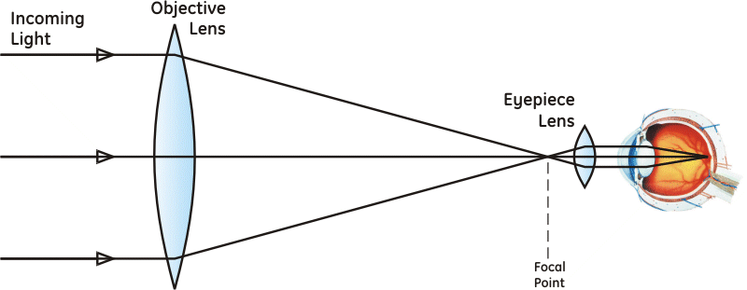
Theory: Exit Pupil
We will use the Exit Pupil to help us pick our scope’s operating points.
??
Exit Pupil
Notes:
The “exit pupil” is the diameter of the cylinder of light coming out of the eyepiece, as shown in the diagram above.
It turns out to be a scope-independent index to where you are on a telescope’s performance curve.

Slide 10
Theory: Why the Exit Pupil?
Well-defined Operating Range (1-7mm)
Universal Scale
  True for every single solitary telescope
  1 mm ➔ maximum magnification point
  2 mm ➔ half max magnification point
  5 mm ➔ half max brightness point
  7 mm ➔ maximum brightness point
These are our reference points
Notes:
Max magnification is probably not a great term to use. Resolution Limit might be better, but doesn’t have the nice symmetry that max magnification has.
Note on “7mm”
if you're matching the telescope performance to your eye, more correctly the formula for M_{min} should be M_{min} = D_{O}/D_{eye}. Then why am I not using that?
First of all, it means I'm requiring you to figure out a way to measure your dark-adapted eye pupil, which is a non-trivial exercise.
Secondly, I'm rarely the only one looking through my scope.
Half the fun of observing is to be able to show other people the coolest stuff you've found.
So I do my figuring based on other people, as well as my own eye, and 7mm is a pretty representative value.
Thirdly, as you can see on the Surface Brightness Page, assuming a 7mm eye pupil makes calculating percent surface brightness a breeze.

Slide 11
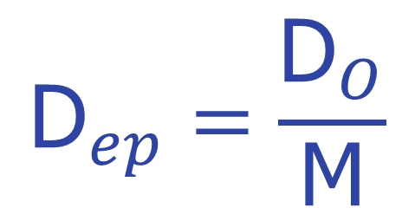
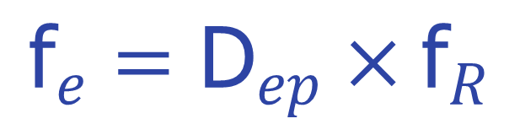
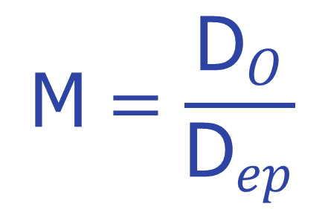
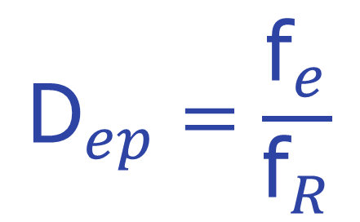
Theory: Using the Exit Pupil
Magnification
$${\text{D}}_{ep}=\frac{{\text{D}}_{O}}{\text{M}}$$
$$\text{M}=\frac{{\text{D}}_{O}}{{\text{D}}_{ep}}$$
Eyepiece
$${\text{D}}_{ep}=\frac{{\text{f}}_{e}}{{\text{f}}_{R}}$$
$${\text{f}}_{e}={\text{D}}_{ep}×{\text{f}}_{R}$$
Notes:
Another benefit of relying on the exit pupil is that there are a couple different ways to figure it, which means there are also a couple things we can figure from it when we know it.
These four equations are the most useful and we will rely on them for determination of the operating points of the telescope – that is, which eyepieces we will need and for what types of observing.
Note “the hardware is always on top”: Objective (diameter) over magnification, eyepiece (focal length) over f-ratio.
Objective over exit pupil
The only calculation for hardware here is f_{e}, and that’s a product of two non-hardware numbers: exit pupil times f-ratio.
It’s a memory device so don’t get too semantic about it...
For now note that D_{ep} = D_{O}/M, so the exit pupil goes "inversely" with the magnification M,
meaning that as M gets bigger, the exit pupil gets smaller, and, importantly,
as M gets smaller, the exit pupil gets bigger.

Slide 12
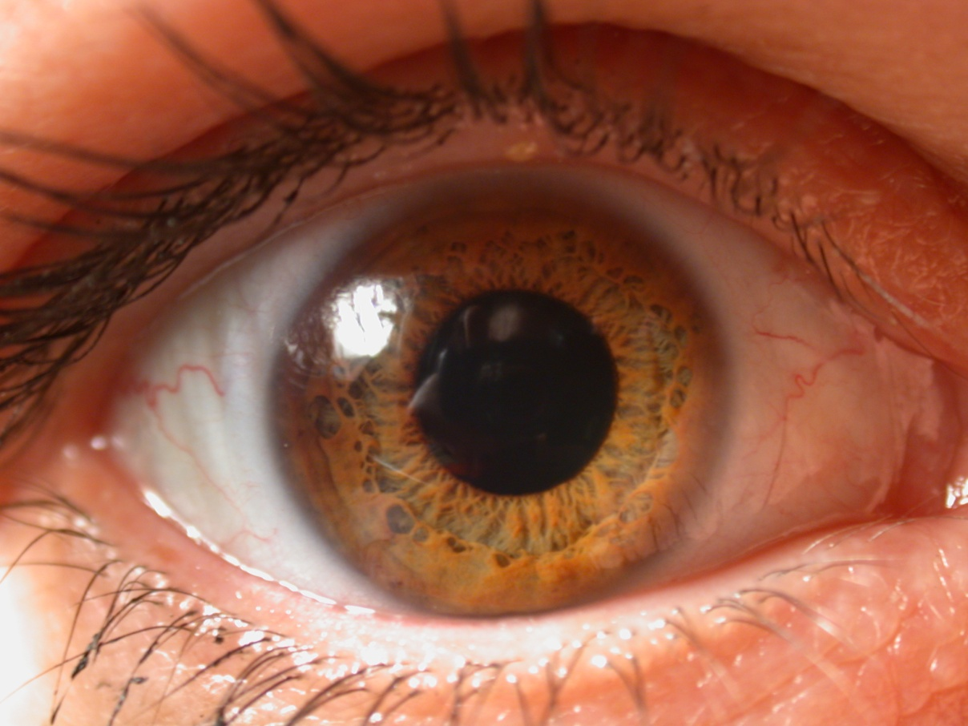
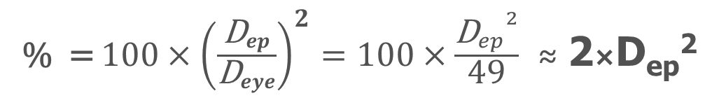
Exit Pupil and Eye Pupil
% = ${100×\left(\frac{{\text{D}}_{ep}}{{\text{D}}_{eye}}\right)}^{2}=100×\frac{{{\text{D}}_{ep}^{}}^{2}}{\text{49}}$ ≈ 2×D_{ep}²
Exit Pupil Area
Eye Pupil Area
Notes:
As magnification gets smaller, the exit pupil gets larger.
The maximum exit pupil size is the size of the eye pupil. When it gets larger than the eye pupil, light is lost and surface brightness no longer increases.
So if we find the area of the exit pupil as a percentage of its maximum (the eye pupil) we also have the percentage of maximum surface brightness.
There are other mathematical ways to show this, but this is a nice intuitive way to remember it.
Since area is proportional to diameter squared, we can take the ratio of the squared diameters to get the percentage.

Slide 13
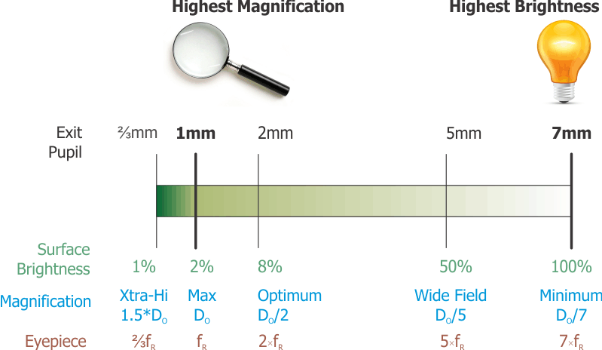
Theory: Operating Points
Notes:
This is a universal scale for telescopes, that allows us to see the scope’s range and our location on that performance curve.
Exit Pupil of 7mm just fits the typical dark-adapted eye pupil, so that is the largest we want to go.
Exit Pupil of 1mm coincides with the point at which the eye can resolve all the detail the scope is capable of providing.
Then we have the following four key reference points on our performance scale:
Maximum magnification:
What we’re calling Maximum Magnification is the point at which the eye can just see all the detail the scope can deliver.
The fact that this occurs when the magnification equals the scope diameter in mm is not only surprising, it’s incredibly convenient. It’s also pretty easy to show.
D_{ep} = D_{O}/M_{max} = D_{O}/D_{O} = 1 mm.
This might be a bit of a surprise: at max magnification, where the scope's resolution matches your eye's resolution, the exit pupil is exactly 1 mm.
Also it gets smaller as you go to higher power, so if you can see the Airy disk the exit pupil is less than or equal to 1mm.
Here we have a magnification of D_{O}, an eyepiece focal length of f_{R}, and a surface brightness of SB(%) = 2×D_{ep}² = 2×1² = 2%.
Note: How to “easily show” M_{max} = D_{O}:
With 20/20 vision, the eye can resolve points separated by 2 arc-minutes (120 arc-seconds)
For example, the lines of the “E” on the 20/20 line of an eye chart are 120 arc-seconds apart.
I want to multiply the scope’s resolving power, in arc-seconds to what the eye can see, 120 arc-seconds.
<go to the Telescope Properties slide>But the scope’s resolving power is 120/D_{O}. So if I multiply by magnification of D_{O} I will get the 120 that I need. QED
Optimum (half-maximum) magnification:
we will assume the optimum is at 2mm, as this actually is closest to the true optimum (2.4mm), is an easy point to remember and simple for mental calculations.
Bear in mind, though, that anywhere on the range between 2 and 3mm pretty much hits it.
Then we have M = D_{O}/D_{ep} = D_{O}/2, f_{e} = D_{ep}×f_{R} = 2×f_{R}, and a surface brightness of SB(%) = 2×D_{ep}² = 2×2²; = 8%.
Note that this optimum is at half maximum magnification.
Maximum Brightness:
We found brightest image, which also has the widest field of view, by setting the magnification to give us an exit pupil of 7 mm -- the minimum magnification we will want to use.
At this point we have a magnification of M = D_{O}/D_{ep} = D_{O}/7, eyepiece focal length f_{e} = 7×f_{R}, and a surface brightness of 100%.
Wide Field:
by backing down from a 7mm exit pupil to 5mm, we arrive at a point that is half maximum brightness,
resulting in an eyepiece focal length f_{e} = 5×f_{R} that sometimes is more available than the maximum eyepiece focal length.
This point, with 50% max brightness and 70% of widest possible field of view (so we can still call it "wide field"), represents a good compromise in brightness vs. magnification for deep-sky observation.
To these four critical points we will add one additional point, an
"Extra-high" resolution point,
introduced because max magnification brings the scope's resolving power to where your eye can just see it.
We can push the scope a little beyond its performance range at the high power end, to make the detail a bit easier to see.
As you go past the limit of the scope's performance you can see the effect, in the form of progressively greater rounding or blurring of edges.
We therefore will stop at 50% higher magnification, or 1.5×M_{max} = 1.5×D_{O}, before the blurring (not to mention the image darkening) becomes objectionable.
Setting an extra-high magnification M = 1.5×M_{max} leads to a D_{ep} = D_{O}/M = D_{O}/(1.5×D_{O}) = ²/₃mm.
Then the dynamic range for the exit pupil is fundamentally from 1 to 7 mm, with three additional reference points noted for a total of 5 points on the scale. These are points to consider when selecting a set of eyepieces for use with a given scope:
Maximum Brightness; D_{ep} = 7mm
Half-Maximum Brightness; D_{ep} = 5mm
Half-Maximum Magnification; D_{ep} = 2mm
Maximum Magnification; D_{ep} = 1mm
Extra-High Magnification; D_{ep} = ²/₃mm

Slide 14
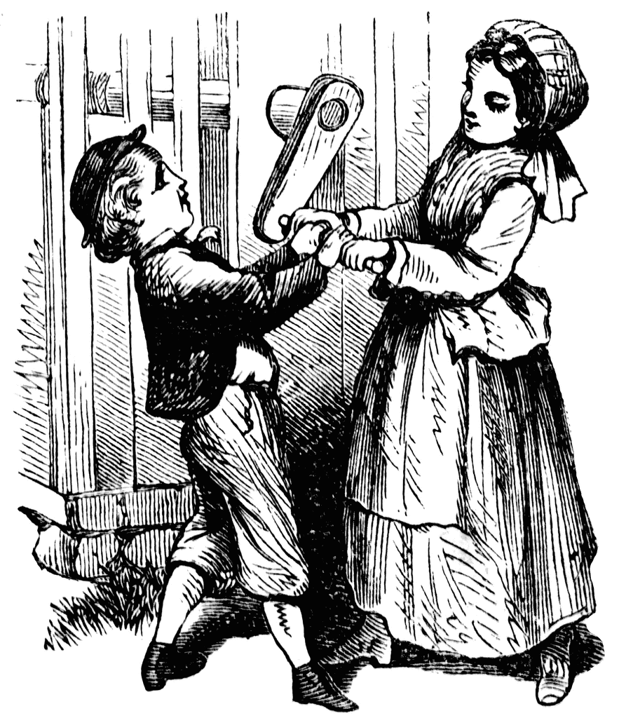
Process
Notes:
So then here’s how we are going to go about analyzing and outfitting our telescope.

Slide 15
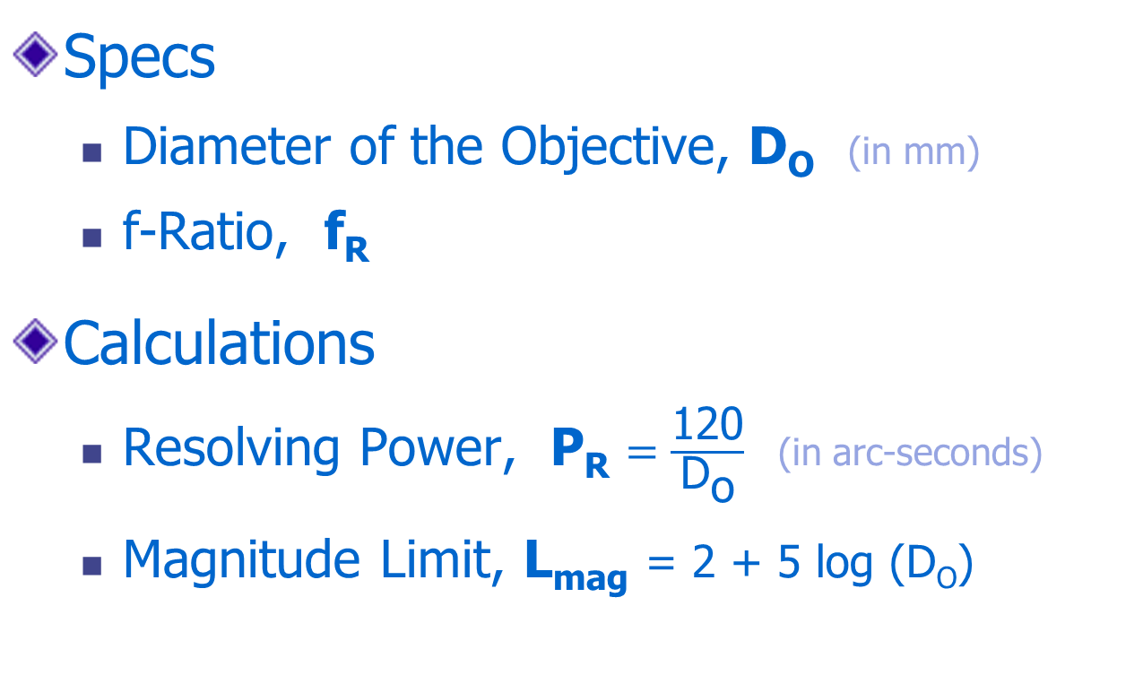
Process: Telescope Properties
Specs
  Diameter of the Objective, D_{O} (in mm)
  f-Ratio, f_{R}
Calculations
  Resolving Power, P_{R} $=\frac{\text{120}}{{\text{D}}_{\text{o}}}$ (in arc-seconds)
  Magnitude Limit, L_{mag} = 2 + 5 log (D_{O})
Notes:
Properties that are intrinsic to the scope are those that depend only on the objective lens or mirror.
The diameter of the objective and the f-ratio are given on the scope
The resolving power is the smallest separation between two stars that can possibly be distinguished with the scope.
Notice how, as the diameter of the scope gets larger, the separation that the scope can distinguish gets smaller, meaning the scope can see tinier, finer detail.
The magnitude limit is the faintest star brightness the scope can detect.

Slide 16
Process: Operating Points
We Will Either Choose or Figure:
  Eyepiece focal length f_{e} (in mm)
  Diameter of the exit pupil D_{ep}
  Scope Magnification M
We Always Calculate:
  Surface Brightness SB = 2×D_{ep}²
Notes:
Once we’ve determined the telescope properties, we can move on to selecting the operating points.
With each one, we will be going after these four values... which one we start with will depend on the operating point and what we know.

Slide 17
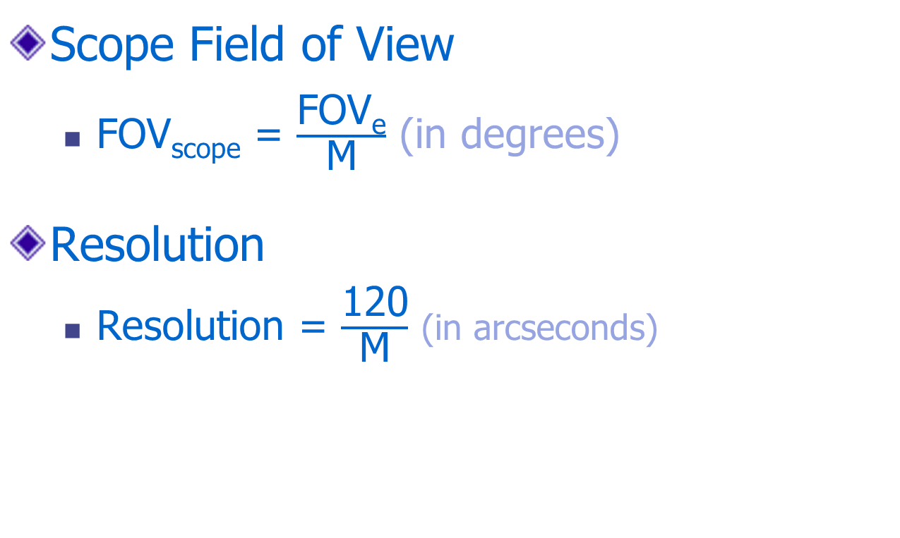
Extra Credit!
Scope Field of View
  FOV_{scope} = $\frac{\text{FOV}\text{e}}{\text{M}}$ (in degrees)
Resolution
  Resolution = $\frac{\text{120}}{\text{M}}$ (in arcseconds)
Notes:
Once I have magnification, I can easily find what exactly that magnification will show me:
Scope Field of View: how much of the sky I will be able to see – can I see the entire Pleiades or just like two stars?
Resolution: how much detail can I see with this eyepiece – sure the scope can split the two stars but can I see that at this magnification?
You get the apparent FOV of the eyepiece from the manufacturer’s specs. Some points of reference:
Most common eyepieces (like ones that come with the scope) are Plössl design, which has about 50° apparent FOV.
Wide FOV eyepieces range from 70-100° (and wider); typical is Erfle at 70° or Nagler design which is 82°.
Older eyepieces like Orthoscopic, which might be good for planets, are around 45°.
2” barrels will give you a wider FOV that 1.25”.
Why not get the widest FOV you possibly can? 1. Cost, 2. Distortion.

Slide 18
Enough. Let’s Go Get Some
Examples

Slide 19
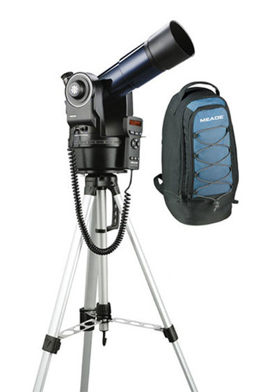
Meade ETX-80BB Backpack Observatory
Scope Properties
  D_{O} = 80mm
  f_{R} = 5
  P_{R} = 120/D_{O} = 120/80
  = 1.5 arc-seconds
  L_{mag} = 2 + 5 log(D_{O})
  = 2 + 5 log(80) = 11.5
Notes:
Portability of a scope can be critical, because if you can't take the scope where you're going then it's no scope at all. This one is an f/5 with an 80mm aperture, comes with an extra-light tripod and its own backpack.

Slide 20

Meade ETX-80BB Operating Points
Max Magnification
M_{max} = D_{O} = 80 is within atmosphere limits
D_{ep} = D_{O}/M = 80/80 = 1mm
(because we are at max magnification, not limited by the atmosphere)
f_{e} = D_{ep} * f_{R} = 1*5 = 5mm
SB = 2*D_{ep}² = 2*1² = 2%
Notes:
Meade claims the highest useful magnification of this scope is 160. What do you think?
This analysis shows that is past the point of matching your eye's resolving power by a factor of 2, so the resulting image would be blurry.
Also, our analysis shows you would need
a Barlow doubler with a 5mm eyepiece or else
a 2.5mm eyepiece (tough to find) to double the M_{max} of 80 and get to 160x.

Slide 21
Meade ETX-80BB Operating Points
Max Brightness
f_{e} = 7 * f_{R} = 7*5 = 35mm
(certainly available)
D_{ep} = f_{e}/f_{R} = 35/5 = 7mm
(because you can reach maximum brightness)
M_{min} = D_{O}/D_{ep} = 80/7 = 11.4
(hmm... about the same as binoculars?)
SB = 100% since we are at minimum magnification.
Notes:
The brightness number comes out looking good, but the small diameter means you get a bright image with pretty lame magnification.
At a magnification of 11.4, a good pair of 10x50 binoculars would give this scope, using a 35mm eyepiece, some stiff competition.
That means it's not likely you want to operate there.
The scope actually comes with two eyepieces, a 9.7mm and a 26mm. Let's see what the operating point is for each.

Slide 22
Meade ETX-80BB Operating Points
26 mm Eyepiece
f_{e} = 26mm,
call it 25mm to calculate faster, only 4% error.
D_{ep} = f_{e}/f_{R} = 25/5 = 5mm
M = D_{O}/D_{ep} = 80/5 = 16
SB = 2*D_{ep}² = 2*5² = 50%
(they picked the half-max brightness point)
Extra credit: FOV_{e} = 52°, FOV_{scope} = 52/16 = 3.25°
Extra credit: Resolution = 120/16 = 7.5 arcseconds
Notes:
This delivers a more decent (not awesome) magnification than the 35mm eyepiece at a reasonable brightness.
Could be useful to survey the sky, and to show your friends a good wide-field view of things like the moon or the Pleiades.
See how rounding made it easy to do these in your head?

Slide 23
Meade ETX-80BB Operating Points
9.7 mm Eyepiece
f_{e} = 9.7mm,
call it 10mm since that's clearly easier to calculate with only a 3% error.
D_{ep} = f_{e}/f_{R} = 10/5 = 2mm
M = D_{O}/D_{ep} = 80/2 = 40
(they picked the half-max magnification point)
SB = 2*D_{ep}² = 2*2² = 8%
Extra credit: FOV_{e} = 52°, FOV_{scope} = 52/40 = 1.3°
Extra credit: Resolution = 120/40 = 3 arcseconds
Notes:
As mentioned elsewhere, a 2mm exit pupil provides the optimum for the resolving power of the eye, which makes this an interesting choice on the part of Meade.
This is probably the eyepiece you would like with this scope.
This scope has an internal, switchable Barlow doubler that will double the magnification of the eyepiece.
That means this eyepiece can take the scope to its max magnification of 80,
with an FOV of 0.65 and
resolution of 1.5 arcseconds.

Slide 24
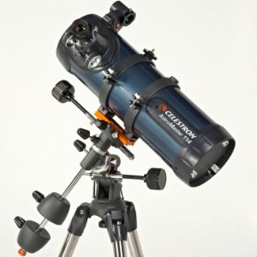
Celestron AstroMaster 114 EQ Reflector
Scope Properties
  D_{O} = 114mm
  f_{R} = 9
  P_{R} = 120/D_{O} = 120/114
  = 1.1 arc-seconds
  L_{mag} = 2 + 5 log(D_{O})
  = 2 + 5 log(80) = 12.3
Notes:
A bigger scope with a longer f-ratio, on a German equatorial mount (my favorite) and excellent reviews, so let's have a look at this one.

Slide 25
Celestron AstroMaster Operating Points
Max Magnification
M_{max} = D_{O} = 114 is within atmosphere limits
D_{ep} = D_{O}/M = 114/114 = 1mm
(because we are at max magnification, not limited by the atmosphere)
f_{e} = D_{ep} * f_{R} = 1*9 = 9mm
SB = 2*D_{ep}² = 2*1² = 2%
Notes:
Celestron claims the highest useful magnification to be 269 –
they are using the formula 60× scope diameter in inches, which you will see in some references and some sites on the internet.
Since it is more than double the point where your eye sees all of the scope's detail, the images will be very blurry, and
dim with an exit pupil of 114/269 = 0.42mm and SB = 2*0.42² = 0.4%.
The operating point we find here with a 9mm eyepiece is quite good, though, and matches up well with the 10mm eyepiece they provide with the scope.
Along with the 10mm you also get a 20mm eyepiece which puts you at the half-max magnification point, close to the optimum resolution.
A slightly shorter focal length of 6 or 7mm might also be handy to have.

Slide 26
Celestron AstroMaster Operating Points
Max Brightness
f_{e} = 7×f_{R} = 7×9 = 63mm
can’t find this, so call it 40mm
D_{ep} = f_{e}/f_{R} = 40/9 = 4.4mm
M_{min} = D_{O}/D_{ep} = 114/4.4 ≈ 26
SB = 2×Dep² = 2×4.4² ≈ 40%
Notes:
The higher f-ratio limits the surface brightness you can achieve with this scope, but gets you to maximum magnification with a reasonable eyepiece focal length.
Seeing faint nebulas or galaxies with this scope will be a challenge.
A 40mm eyepiece gets to 40% surface brightness and yields a 26x magnification, which is a bit low, and
the 20mm eyepiece, the longest focal length provided with the scope, has a D_{ep} = 20/9 = 2.2mm, a magnification of M = D_{O}/D_{ep} = 114/2.2 = 51, pretty decent, and SB = 2*2.2² = 10% -- not horrible but not particularly good for deep sky observing.

Slide 27
Celestron AstroMaster Operating Points
20 mm Eyepiece
f_{e} = 20mm
D_{ep} = f_{e}/f_{R} = 20/9 = 2.2mm
M = D_{O}/D_{ep} = 114/9 = 51
(pretty decent)
SB = 2×D_{ep}² = 2×2.2² = 10%
(not horrible, not great for deep sky either)
Extra credit: FOV_{e} = 50°, FOV_{scope} = 50/51 = 1°
Extra credit: Resolution = 120/50 = 2.4 arcseconds

Slide 28
Celestron AstroMaster Operating Points
10 mm Eyepiece
f_{e} = 10mm
D_{ep} = f_{e}/f_{R} = 10/9 = 1.1mm
M = D_{O}/D_{ep} = 114/1.1 = 104
(slightly below max magnification point)
SB = 2*D_{ep}² = 2*1.1² = 2.4%
Extra credit: FOV_{e} = 50°, FOV_{scope} = 50/104 = 0.5°
Extra credit: Resolution = 120/104 = 1.2 arcseconds
Notes:
Special Note: The deep-sky (brightness) vs. magnification limitations you see with this scope and the previous one are not a reflection against the scopes -- they are both great for what they do and have gotten great reviews. What this is showing is the motivation that astronomy enthusiasts have for going with larger diameter, also heavier and costlier, telescopes.

Slide 29
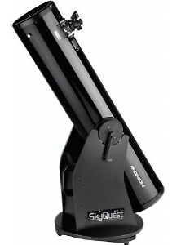
Orion SkyQuest XT8 Classic Dobsonian
Scope Properties
  D_{O} = 203mm
  f_{R} = 6
  P_{R} = 120/D_{O} = 120/203
  = 0.6 arc-seconds
  L_{mag} = 2 + 5 log(D_{O})
  = 2 + 5 log(203) = 13.5
Notes:
A really popular 8-inch scope on a Dobsonian mount.

Slide 30
Orion SkyQuest XT8 Operating Points
Max Magnification
M_{max} = D_{O} = 203 is within atmosphere limits (just barely)
D_{ep} = D_{O}/M = 203/203 = 1mm
(because we are at max magnification, not limited by the atmosphere)
f_{e} = D_{ep} * f_{R} = 1*6 = 6mm
SB = 2*D_{ep}² = 2*1² = 2%
Notes:
Orion claims the highest useful magnification to be 300 –
and this one can be defended, as it aligns with the recommendation made in the "Theory" section above.
On the other hand, the atmosphere will not allow you more than a magnification of 200, and usually much less.
So getting to a magnification of 200 with a 6mm eyepiece is likely to be all you would ever need with this scope.
A 4mm eyepiece (or 8mm with a 2x Barlow) might be interesting to use for testing purposes, and would be less useful for observing.

Slide 31
Orion SkyQuest XT8 Operating Points
Max Brightness
f_{e} = 7×f_{R} = 7×6 = 42mm
Period. Get one of those for this scope.
D_{ep} = f_{e}/f_{R} = 42/6 = 7mm
by definition since we are at minimum magnification.
M_{min} = D_{O}/D_{ep} = 203/7 = 29
SB = 100%
by definition since we are at minimum magnification.
Notes:
Check it out -- maximum telescope brightness reached at a magnification of 29. Very decent.
A 10" scope hits this point with a magnification of 36, provided it has a low enough f-ratio (6 or less).

Slide 32
Orion SkyQuest XT8 Operating Points
Half-Max Magnification
D_{ep} = 2mm
f_{e} = D_{ep}×f_{R} = 2×6 = 12mm
M = D_{O}/D_{ep} = 203/2 = 102
SB = 2×D_{ep}² = 2×2² = 8%
Extra credit: FOV_{e} depends on actual eyepiece chosen
Extra credit: Resolution = 120/102 = 1.2 arcseconds

Slide 33
Orion SkyQuest XT8 Operating Points
Half-Max Brightness
D_{ep} = 5mm
f_{e} = D_{ep}×f_{R} = 5×6 = 30mm
M = D_{O}/D_{ep} = 203/5 = 40
(pretty decent for deep sky)
SB = 2*D_{ep}² = 2*5² = 50%
Extra credit: FOV_{e} depends on actual eyepiece chosen
Extra credit: Resolution = 120/40 = 3 arcseconds
Notes:
Orion gives you a 25mm eyepiece with the scope, you could count that as close enough.
So with an eyepiece set of 6mm, 12mm, 30mm, and 42mm, you have the full range nicely covered, all the way from the maximum magnification allowed by the atmosphere to an image that is 100% brightness. Pretty sweet.

Slide 34
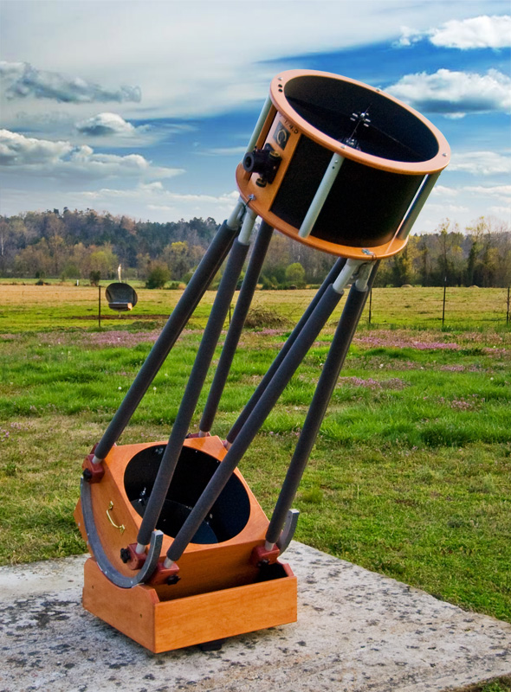
Obsession Telescopes 18-inch Dobsonian
Scope Properties
  D_{O} = 18"×25.4 = 457mm
  f_{R} = 4.5
  P_{R} = 120/D_{O} = 120/457
  = 0.3 arc-seconds
  L_{mag} = 2 + 5 log(D_{O})
  = 2 + 5 log(203) = 15.3
Notes:
One last example, we might as well take a look at a monster. Especially since we have two of them on the grounds.
L_{mag} of 15.3. Wow. Pulling in the eighth, ninth, and maybe tenth brightest moons of Saturn (Hyperion, Janus, & Epimetheus).

Slide 35

Obsession 18-inch Operating Points
Max Magnification
M_{max} = D_{O} = 457 oh, ah.... no.
Limited by the atmosphere, call it 200
D_{ep} = D_{O}/M = 457/200 = 2.3mm
f_{e} = D_{ep} * f_{R} = 2.3*4.5 = 10mm
SB = 2*D_{ep}² = 2*2.3² = 10.4% (at 200x!!)
Notes:
Not on this planet, as long as we continue to enjoy a breathable atmosphere.
In this case we are going to define M_{max} to be what we think is achievable, and I would call that 200.
It's a judgement call, and you might go with a different value, the arithmetic follows the same process as is done here.
Going beyond this point in magnification will simply provide a really close, detailed view of the blurring and distortion being produced by atmospheric conditions.
Look at the surface brightness, though, at 200x: 10.4%, more than 5 times what the 8" gives us at that magnification. This is the point of the bigger scope.

Slide 36
Obsession 18-inch Operating Points
Max Brightness
f_{e} = 7×f_{R} = 7×4.5 = 32mm
Easy to get.
D_{ep} = f_{e}/f_{R} = 32/4.5 = 7mm
by definition since we are at minimum magnification.
M_{min} = D_{O}/D_{ep} = 457/7 = 65.3
Wuh-what??? This is minimum magnification
SB = 100%
by definition since we are at minimum magnification.
Notes:
Since the magnification is so high at maximum brightness, the deep sky images are to die for.
The Ring Nebula jumps out at you even under a full moon. A scope like this is a deep-sky explorer's dream.

Slide 37
Obsession 18-inch Operating Points
Half-Max Magnification
Pretty much what we picked for max magnification, 200x
At magnification 200x, Dep = 2.3mm which hits the optimum point for the eye to resolve
Extra credit: FOV_{e} depends on actual eyepiece chosen
Extra credit: Resolution = 120/200 = 0.6 arcseconds

Slide 38
Obsession 18-inch Operating Points
Half-Max Brightness
D_{ep} = 5mm
f_{e} = D_{ep}×f_{R} = 5×4.5 = 22.5mm
M = D_{O}/D_{ep} = 457/5 = 91
(pretty decent for deep sky)
SB = 2*D_{ep}² = 2*5² = 50%
Extra credit: FOV_{e} depends on actual eyepiece chosen
Extra credit: Resolution = 120/90 = 1.3 arcseconds
Notes:
Televue makes a nice 22mm (I didn't say cheap) and I think Celestron's got one as well, both with 2" barrel which would fit this scope.
20mm is a little easier to find... in any event this operating point is reasonably achievable.
We're not even going to discuss extra-high magnification with this scope.
So then you're really pretty much set with an eyepiece that's got about a 10mm focal length, one that's about 20mm, and one that's about 30mm.
More than just these three does not make a lot of sense.

Slide 39
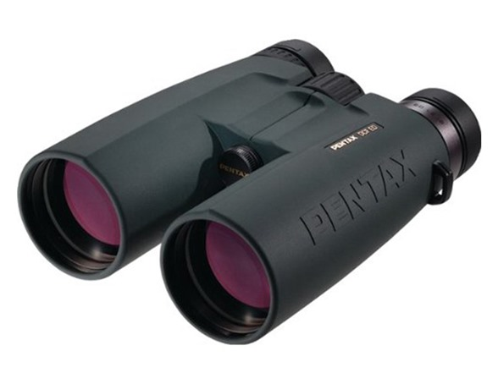
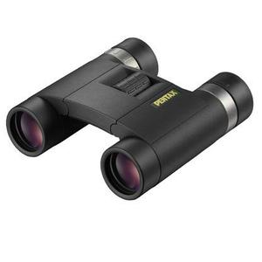
What About Binoculars?
Pentax DCF SP 10×50
  M = 10
  D_{O} = 50mm
  D_{ep} = D_{O}/M = 5mm
  SB = 2×5² = 50%
Pentax DCF SW 10×25
  D_{ep} = 25/10 = 2.5mm
  SB = 2×2.5² = 12.5%
Extra credit: Resolution = 120/10 = 12 arcseconds

Slide 40
So... what have we learned?
Exit Pupil
End points:
  Highest magnification, then
  Highest brightness
Practical considerations
  Atmosphere
  Eyepiece availability
Two intermediate operating points
  Half maximum magnification
  Half maximum brightness
Notes:
You can see how the performance scale provides a framework that helps with sizing up and setting up a scope.
The exit pupil serves as a central reference point for calculations. Always going first to the exit pupil does three things for you:
Tells you where you are on the performance scale.
Keeps it simple: you always know what to do first
Positions you to quickly calculate magnification, eyepiece, and surface brightness.
We use the end points of the scale to bracket the operating range: highest magnification, then highest brightness.
We included practical considerations in the analysis:
whether the highest achievable magnification is limited by the atmosphere, and
whether the longest focal length eyepiece is decided by what's available.
The two intermediate operating points —
half the scope's maximum magnification and
half the maximum brightness —
serve as additional guideposts which help us to understand our choices of operating points for the scope.
We didn't try to nail down an answer to five-decimal-place accuracy.
We found what eyepieces to use with the scope and how to use them.
There are only so many choices for eyepieces that are available on the market, and ultimately performance is subjective.
It will depend on the target being observed, the observing conditions and YOU, the observer.
The goal is finding where you want to be, then getting as close as reasonable.

Slide 41
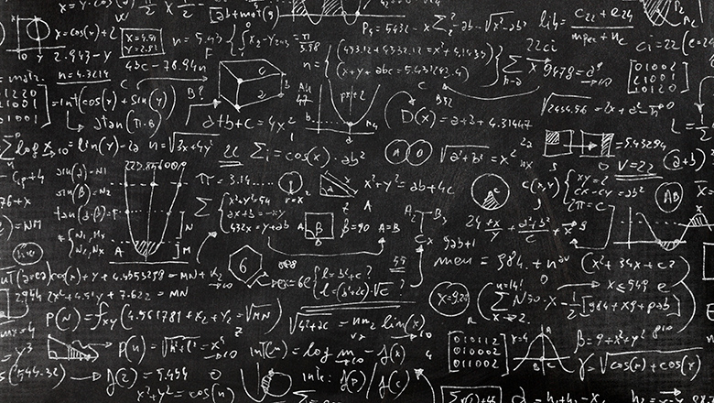
That wasn’t so bad, was it?

Slide 42
Appendix
Notes:
Special Note: The deep-sky (brightness) vs. magnification limitations you see with this scope and the previous one are not a reflection against the scopes -- they are both great for what they do and have gotten great reviews. What this is showing is the motivation that astronomy enthusiasts have for going with larger diameter, also heavier and costlier, telescopes.

Slide 43
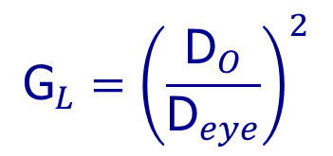
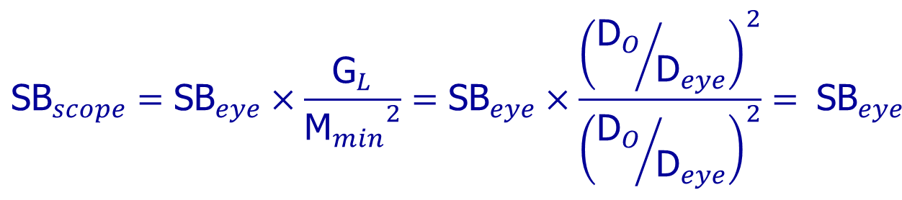
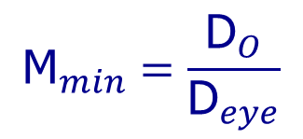
Maximum Surface Brightness
$${\text{G}}_{L}={\left(\frac{{\text{D}}_{O}}{{\text{D}}_{eye}}\right)}^{2}$$
$${\text{M}}_{min}=\frac{{\text{D}}_{O}}{{\text{D}}_{eye}}$$
$${\text{SB}}_{scope}={\text{SB}}_{eye}×\frac{{\text{G}}_{L}}{{{\text{M}}_{min}}^{2}}={\text{SB}}_{eye}×\frac{{\left({{\text{D}}_{O}}/{{\text{D}}_{eye}}\right)}^{2}}{{\left({{\text{D}}_{O}}/{{\text{D}}_{eye}}\right)}^{2}}= {\text{SB}}_{eye}$$
!
Notes:
Buzz buzz buzz hand-wave hand-wave TA-DAAAA.
If you still don’t believe me you can check the slides on the website later. The math is totally legit.
We figured out that at minimum magnification I get the brightest image the scope can conjure up. But just how bright is that image?
I only derive this result because otherwise you would not believe me when I told you...
==============================================================
As shown on the Minimum Magnification page, the maximum surface brightness for extended sources, like planets and nebulae, is achieved with the minimum magnification for the telescope. Let's figure out just how bright that is.
The total gain in light that the telescope collects, over that of the eye alone, we call it G_{L}, is shown on the Magnitude Gain page to be G_{L}=(D_{O}/D_{eye})².
Where D_{O} is the diameter of the objective and D_{eye} is the diameter of the eye pupil. Also shown on the Minimum Magnification page is the equation for magnification in the form M_{min}=D_{O}/D_{ep}.
Where D_{ep} is the diameter of the exit pupil. And it is also noted on that page that the surface brightness of an object is reduced by the magnification squared, because the light is distributed over a larger area... there are a lot of things discussed on the minimum magnification page, aren't there?...
So the surface brightness of an object that you see with your eye, which I'm going to call "SB_{eye}" because I don't have much imagination, is multiplied by G_{L} and then divided by M², resulting in the surface brightness you see in the scope, which I'm going to call "SB_{scope}" for the same reason as above.
When the exit pupil diameter, D_{ep}, equals the diameter of the pupil of the eye, D_{eye}, like at minimum magnification, we have the very interesting result for the net result in SB_{scope} at minimum magnification as shown.
What the heck is that saying? What -- that the very brightest image I can get with the scope is exactly the same brightness that I see with the naked eye??????
Yup.

Slide 44
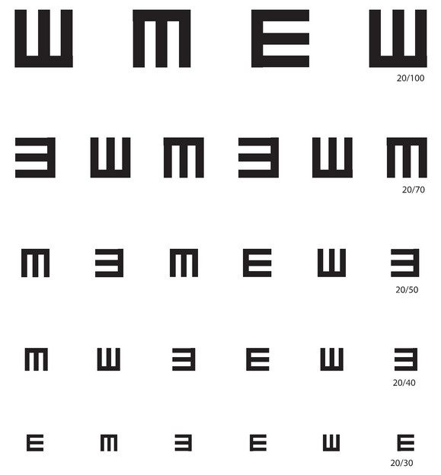
20/20 Vision = 2 arcminutes
Eyechart for 20/20 vision
Each line & space is 1 arcminute thick
So the lines are
2 arcminutes apart

Slide 45
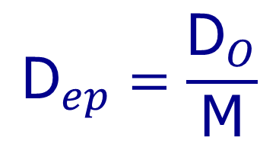
Exit Pupil Tracks Scope FOV
Both depend on magnification
As magnification gets bigger, both get smaller
Exit pupil gets smaller, FOV gets smaller, so you see a smaller part of the picture... in fact:
The size of the exit pupil shows how much of the picture from the scope goes in the eye.
$${\text{D}}_{ep}=\frac{{\text{D}}_{O}}{\text{M}}$$
FOV_{e}
FOV_{scope} =
M
Notes:
...and how much of the picture from the scope equates to how much of the total light from the scope is going into the eye.

Slide 46
Exit Pupil at High Magnification
High magnification, small scope FOV, small exit pupil
Notes:
So at high magnification, we have a small field of view, which means a small portion of the light from the scope, coming into the eye through a small exit pupil.

Slide 47
Exit Pupil at Low Magnification
Low magnification, large scope FOV, large exit pupil
Notes:
And at lower magnification, we have a larger field of view, which means more of the light from the scope, and it’s coming into the eye through a larger exit pupil.

Slide 48
What Happens Now?
Magnification so low, exit pupil is BIGGER than eye pupil
Notes:
What happens if I keep reducing the magnification to make the image brighter, and I end up making the exit pupil bigger than your eye pupil?
Well then the additional light from the scope simply cannot enter the eye.
Everything outside that red circle, the additional light that would have made the image brighter, is lost.
Once the exit pupil reaches the size of your eye pupil, that’s the brightest the image will get.
As magnification is reduced further, the image gets smaller but NO BRIGHTER.

Slide 49
Theory: finding the Exit Pupil
$${\text{D}}_{ep}=\frac{{\text{D}}_{O}}{\text{M}}$$
Scope Diameter & Magnification
$${\text{D}}_{ep}=\frac{{\text{f}}_{e}}{{\text{f}}_{R}}$$
Eyepiece and
f-Ratio
Notes:
There are two ways to find the exit pupil: scope diameter to magnification, and eyepiece to f-ratio.
These two equations are simple and easy to work with, and as you will see, they are very handy.

Slide 50
Operating Points: Highest Res
Maximum Magnification
  M_{max} = D_{O}, limited by atmosphere to 200
Exit Pupil
  D_{ep} = D_{O}/M
Eyepiece Focal Length
  f_{e} = D_{ep}×f_{R}
Surface Brightness
  SB = 2×D_{ep}²
Notes:
We go to the highest resolution and check to see if D_{ep} = 1 is achievable.
If we are limited in magnification by the atmosphere, D_{O} of 8” or more, then we determine f_{e}, D_{ep}, and SB at M = 200

Slide 51
Highest Brightness
Eyepiece Focal Length
  f_{e} = 7×f_{R}, or longest focal length available
Exit Pupil
  D_{ep} = f_{e}/f_{R}, f_{e} as determined above
Minimum Magnification
  M_{max} = D_{O}/D_{ep}
Surface Brightness
  SB = 2×D_{ep}²
Notes:
We then go to the highest brightness and see if D_{ep} is achievable, that is, can we get an eyepiece with f_{e} = 7×f_{R}?
If not, we go with the highest f_{e} available and find D_{ep}, M_{min}, and SB from that.

Slide 52
Intermediate Points
Half-Maximum Magnification
  Set D_{ep} = 2mm, f_{e} = 2×f_{R}, M = D_{O}/2
Half-Maximum Brightness
  Set D_{ep} = 5mm, f_{e} = 5×f_{R}, SB = 50%
Extra-High Magnification
  1.5×M_{max} can make fine detail easier to see, but does not present further detail.
  At SB of 1%, this point is more for planets, double stars, and scope testing.
Notes:
Depending on how the upper and lower limits of D_{ep} worked out, we may then look at the following intermediate points:
Half-Max Magnification: the 2mm exit pupil hits the optimum resolution for the eye.
Half-Max Brightness: 70% max FOV, good compromise for deep-sky viewing
Extra-High Magnification: since max magnification makes the scope’s smallest detail just big enough to see, going a little bigger can make the detail easier to see, but adds no further detail. Much more than 50% higher makes the image dimmer and fuzzier without necessarily adding value.

Slide 53
Wait, so what are we doing?
Telescope Properties
  Resolving Power; Magnitude Limit
Operating Points
  Max Magnification, Max Brightness
  Half Max Mag, Half Max Brightness
For Each Operating Point
  Eyepiece f_{e}, FOV_{e}, D_{ep}, Mag, SB
  Extra Credit: FOV_{scope} & Resolution

