Slide 1
Telescope Equations
Useful Formulas for
Exploring the Night Sky
Randy Culp
Notes:
I would like to show you a few simple... in some cases unbelievably simple... formulas that allow you to size up and set up a telescope.
All of this material can be found on my telescope equations site on the web – just Google “Telescope Equations” and it’s the first hit (along with the next four as well).
That site contains all these slides, all these equations plus how they are derived, tonight I will keep it simple, and show you the formulas, the concepts behind them and how to use them.
Note to presenter
The overall logic and flow of the presentation
Scope Resolution
Resolving Power
Magnification
Max Magnification
Scope Brightness
Magnitude Limit
Magnification Dimming
Minimum Magnification
Surface Brightness
How to Size Up a Scope
Telescope Properties
Operating Points

Slide 2
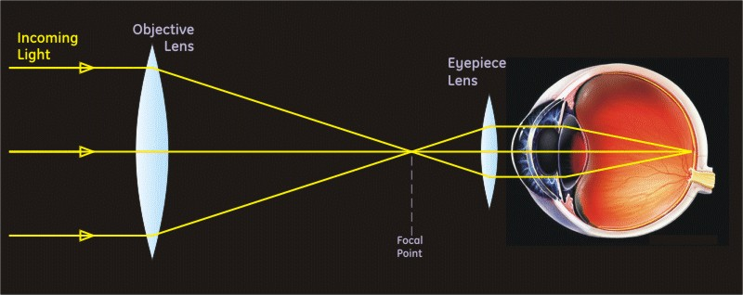
Introduction
Objective lens : collects light and focuses it to a point.
Eyepiece : catches the light as it diverges away from the focal point and bends it back to parallel rays, so your eye can re-focus it to a point.
Notes:
We will be talking specifically about visual observing through the telescope – how the telescope and your eye work together. Understanding photography starts with understanding these ideas, and we are going to stick to visual observation – how the telescope gives your eye a boost.
Stars are so unimaginably far away that the light we receive from them arrives in rays that are perfectly parallel. Your eye is designed to focus these parallel rays to a point, allowing you to identify where the light is coming from.
A telescope, in its original configuration (refractor), consists of two lenses. The first one, the objective lens, collects light and brings it together to a point. The second lens, the eyepiece, catches the light as it diverges away from the focal point and bends it back to parallel rays, so your eye can re-focus it to a point.
This brings more light to your eye to show faint objects, and the arrangement also allows for resolving more detail than your eye alone can do.
So what makes a good scope is one that has
good detail
good brightness

Slide 3
Sizing Up a Telescope
Part 1: Scope Resolution
  Resolving Power
  Magnification
Part 2: Telescope Brightness
  Magnitude Limit: things that are points
  Surface Brightness: things that have area
Notes:
So that’s what we’re going to look at
The scope’s detail: what I will call “scope resolution” –
its resolving power and
magnification
The scope’s brightness: looking at two cases
things that are points, mostly stars, which we characterize with its magnitude limit, and
things that cover an area, like planets, nebulas & galaxies, which we characterize with the term “surface brightness”

Slide 4
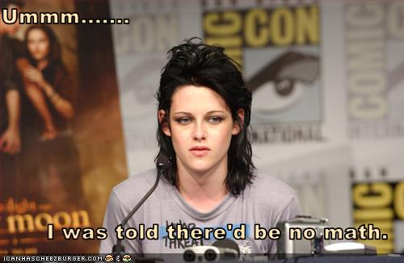
Ooooooo... she came to the wrong place....
Notes:
I’m afraid there will be some math involved... but I will keep it simple.
AND... the real point is to understand the concepts, NOT to memorize the equations, because it’s the concepts that help you make decisions at the scope.

Slide 5
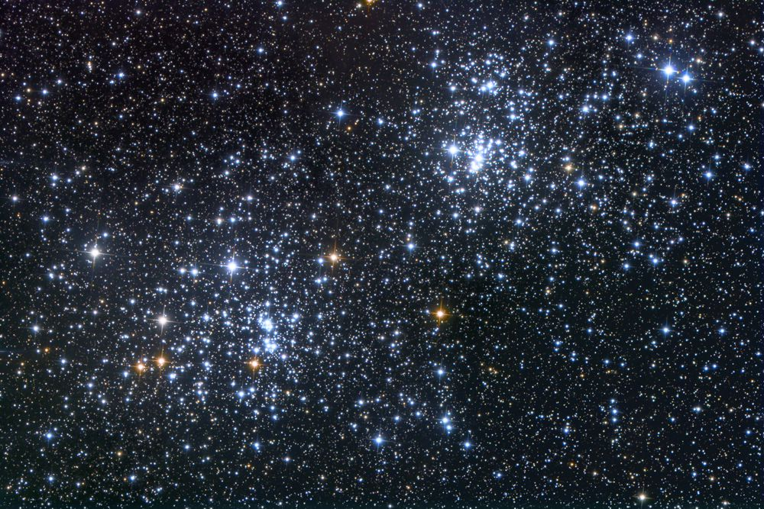
Part 1: Scope Resolution
Notes:
So let’s begin with how the scope gets definition of the tiniest details, through resolving power and magnification.

Slide 6
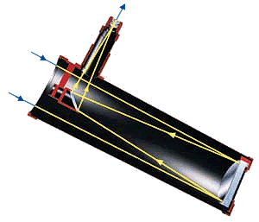
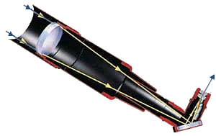
Resolving Power
P_{R}: The smallest separation between two stars that can possibly be distinguished with the scope.
The bigger the diameter of the objective, D_{O}, the tinier the detail I can see.
D_{O}
D_{O}
Refractor
Reflector
Notes:
We use the symbol P_{R} to represent the smallest separation between two stars that shows up as two stars – the better the resolving power, the closer they can be.
This depends entirely, and perhaps surprisingly, only on the diameter of the objective... either the lens for a refractor or the mirror for a reflector... which I’m calling D_{O}. This may be counter-intuitive for you – it is for a lot of people – but it’s true and I will show you why it is.
But first, how do we measure the separation between two stars?

Slide 7
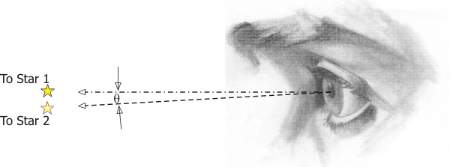
Separation in Arc-Seconds
Separation of stars is expressed as an angle.
One degree = 60 arc-minutes
One arc-minute = 60 arc-seconds
Separation between stars is usually expressed in arc-seconds
Notes:
Everything in the night sky is so far away that it’s not the actual distances between things that we see, it’s the differences in the angle from our vantage point.
For that reason we measure distances and sizes in the scope image in terms of angles – degrees and fractions of degrees.
The actual system is not degrees and decimal degrees, but instead it’s degrees, arc-minutes, and arc-seconds, which works just like hours, minutes & seconds
When stars are very close, then we are measuring their separation in terms of arc-seconds, which is one 3600th of a degree.

Slide 8
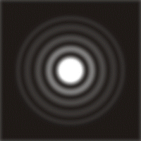
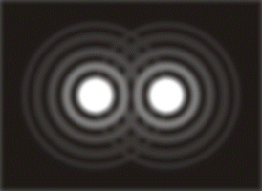
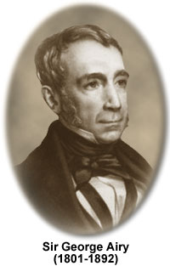
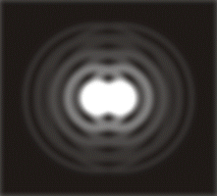
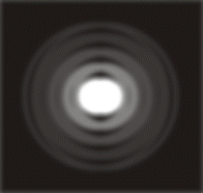
Resolving Power: Airy Disk
Airy Disk
Diffraction Rings
When stars
are closer
than radius
of Airy disk,
cannot
separate
Notes:
Light travels in waves, and if you’ve ever seen waves go through an opening, like water waves going between rocks, they bounce off the sides and bang into each other in the middle. That’s what happens to light when it passes through the lens of your telescope... it bounces off the sides and bangs into itself in the middle.
The result is that when I go to focus the light to a point, I don’t get a point... rather, I get a disk at the center, with a series of alternating dark and light concentric rings progressing away from the disk.
(You can really see this in a small scope, looking at a bright star under a good sky if the scope has good optics and is well-aligned.)
This effect was described and calculated by Sir George Airy in 1834, so it’s called the “Airy Disk”, after Sir George. He showed the size of the disk goes inversely with the aperture – the diameter of the objective, D_{O}. The rings are often called “diffraction rings”.
My ability to tell the two stars apart depends on the size of the Airy disk, and
the size of the Airy disk in turn depends on the diameter of the telescope.
Therefore, my ability to distinguish two close stars depends on the scope diameter.
If I can make the size of the Airy disk smaller, by making the diameter of the scope larger, I can separate stars that are closer.
============================================
So now in the case of your telescope the circular opening of the telescope creates a circular interference pattern.
Because of this interference pattern, when you make an image of a star, it does NOT focus to a perfect point. Rather, it focuses to a disk, and if you set your telescope for high magnification and examine the image carefully, you can see that there is a disk with faint rings around it -- this is the interference pattern that is caused by the circular aperture of your telescope. In fact, this is a special interference pattern and it has a special name -- the "Airy disk" -- named after Sir George Biddell Airy, an English astronomer who described this pattern mathematically in 1834.
The top left is my drawing of an idealized picture of an Airy disk. Then the top right is a drawing of two close stars appearing as two Airy disks.
In the bottom left you see the two stars getting as close together as the radius of the Airy disk, and we start to have trouble telling them apart.
So then in the bottom right you see that when the two stars are closer together than the radius of the Airy disk, we can no longer tell them apart.

Slide 9
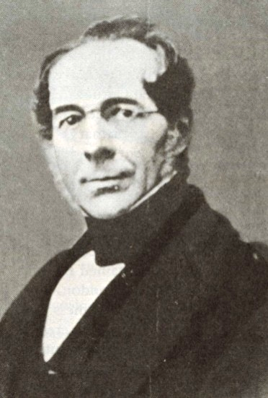
Dawes Limit
Practical limit on resolving power of a scope:
115.8
Dawes Limit:
P_{R} =
D_{O}
...and since 4 decimal places is way too precise...
120
William R. Dawes
(1799-1868)
P_{R} =
D_{O}
P_{R} is in arc-seconds, with D_{O} in mm
Notes:
The formula we will use is based on the “Dawes Limit”.
William Dawes was a contemporary of George Airy and an astronomer who earned the nickname “Eagle Eye”.
Based on practical experience he defined a limit on the separation of two stars that could be resolved by a good observer under good conditions, and this has become known as the “Dawes Limit”.
Consistent with Airy’s findings, this limit depends on the diameter of the scope you’re working with.
I round it to 120 for two reasons: it’s easier to work with, and it will emphasize a very useful coincidence later on.
================================================
The bending of light which causes this interference pattern is known as "diffraction", and the Airy disk is also known as the diffraction pattern of the scope.
The radius of the central disk of this pattern, in radians -- let's call it "R" -- is given by R=1.22λ/D_{O}, where λ is the wavelength of light, which happens to be 550x10⁻⁹m for green light, and D_{O} is the diameter of the objective in meters (for this formula).
With regard to your telescope, what is important in this equation is that the size of the Airy disk depends on the diameter of the objective ONLY, and as the diameter of the objective gets bigger, the Airy disk gets smaller.
This means as the diameter of your scope gets bigger, you can see smaller and smaller detail -- or equivalently, you can split stars that are closer together. Conversely, this means that there is a limit to the detail you can see with your scope. That limit is dictated ENTIRELY by the diameter of the scope, and it is due to the diffraction effects caused by the scope opening.
For this reason, the radius of the Airy disk, as calculated above, is known as the "diffraction limit".
The diffraction limit equation gives an answer in radians, whereas most dimensions in astronomy are given in degrees, minutes, or seconds of arc. Also because of various other factors, the actual limit of detail that an observer can see does not match exactly to the diffraction limit. Interestingly, a skilled observer can do better than the diffraction formula would suggest.
In 1867, William Rutter Dawes determined the practical limit on resolving power for a telescope, known as the Dawes limit. Dawes expressed this as the closest that two stars could be together in the sky and still be seen as two stars. The Dawes Limit is 4.56 seconds of arc, divided by the telescope aperture in inches. We can multiply the Dawes limit by 25.4 to convert to the metric system (in mm), which gets you to 115.8, and then round to a number that is more convenient when doing the math in your head , and we get the resolving power of the scope, P_{R} as 120/D_{O}.
Note that rounding is perfectly ok since these calculations are not so precise as they look - what an observer can resolve depends, after all, on the observer. These limits represent what a really good observer can do under really good conditions.

Slide 10
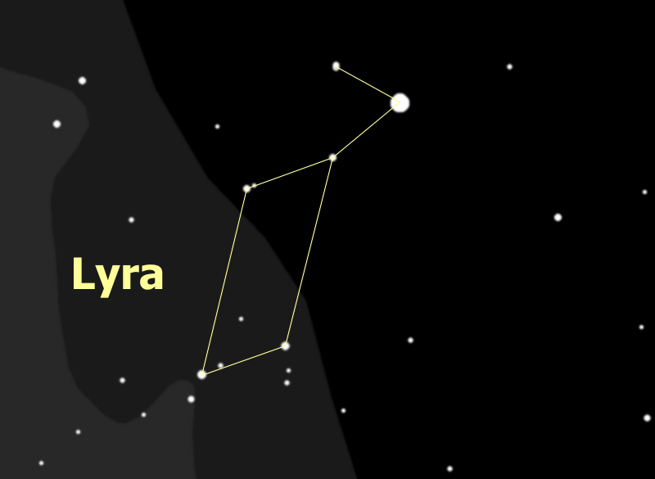
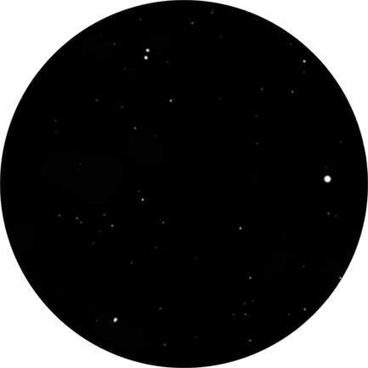
Resolving Power Example
The Double Double
Notes:
Epsilon Lyrae is a famous star, known as "the Double Double", in the constellation Lyra. This star shows as a double star when you look at it in binoculars. But then if you look at it in a telescope, and if the telescope is big enough, you can see that each of the two stars of this double is also a double!
So here's the question: does my 90mm ETX telescope have the resolving power to split the Double Double?

Slide 11
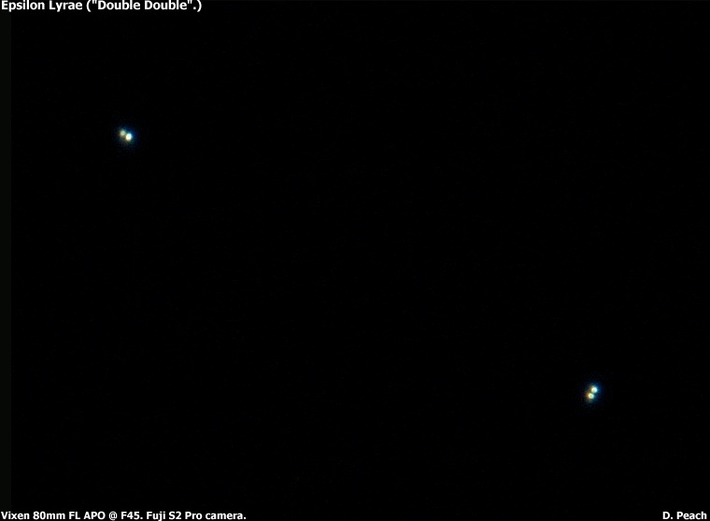
Resolving Power Example
Splitting the Double Double
Components of Epsilon Lyrae
are 2.2 & 2.8 arc-seconds
apart. Can I split them with
my Meade ETX 90?
120
120
P_{R} =
=
D_{O}
90
= 1.33 arc-sec
...so yes
Photo courtesy Damian Peach (www.DamianPeach.com)
Notes:
When we look up the Double Double in a desk reference or on the web we find separations of 2.2 & 2.8 arc-seconds for the two pairs of stars.
To find the resolving power of the ETX we simply divide 120 by 90 to get 1.3, hence the ETX can, at least in theory, split the double double.
I can report to you that in fact I can split the Double Double with my ETX, and do so on a regular basis, just for the sport of it and also to test the atmospheric conditions.
==============================================================
First we look up the Double Double, or Epsilon Lyrae, in a reference like Burnham's Celestial Handbook or find it on the web on a page like the one by Professor James Kaler. Prof. Kaler's page tells us that one pair is 2.8 arc-seconds apart, the other is 2.2, consistent with what Burnham's handbook says.
Then let's see what the resolving power of my ETX ought to be: the Dawes Limit formula says
P_{R}= 120/D_{O}
So I only need to know the diameter of the objective, or D_{O}, for my ETX to figure this one out. Since, as I noted earlier, D_{O} = 90 mm, then P_{R} = 120/90 = 1.33 seconds of arc. Since that is smaller than the separation of the components of Epsilon Lyrae, I should be able to split the Double Double with my scope.
I can report to you that in fact I have been able to split the Double Double with my ETX, which speaks well of the optics on my ETX. I can also report that it requires good atmospheric conditions.
That's because the atmosphere, on an exceptionally good day, will limit your resolution to 0.5 second of arc, more normally it will limit you to about 1 second of arc. On not-so-good days, the atmosphere will limit your resolution to anywhere from 2 to 10 seconds of arc. So while my ETX can split the Double Double, it can't do it every night. But then neither can the bigger scopes -- we all need a clear, steady sky to bag the Double Double.
Notice how the two pairs align at right angles to each other -- one pair aligns North-South, and the other aligns East-West. It's very cool to get this in the eyepiece. These four stars form a set that is a true double-double star, formed from the same nebula, which was spinning so fast it first spun apart into two protostars. They in turn each spun themselves apart into two stars. Today, the two spinning pairs are still orbiting each other.

Slide 12
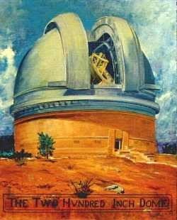
A Note on the Air
Atmospheric conditions are described in terms of “seeing” and “transparency”
Transparency translates to the faintest star that can be seen
Seeing indicates the resolution that the atmosphere allows due to turbulence
Typical is 2-3 arcseconds, a good night is 1 arcsec, Mt. Palomar might get 0.4.
Notes:
You're not just looking through your telescope at the stars, you're also looking through air -- literally tons of air. 50 miles of it straight up, and hundreds of miles when you're looking close to the horizon. That air is usually in motion, and the shifting masses of air at different temperatures cause the light to deflect. The deflection is small and subtle, but when you are looking at high magnification, it seriously affects the amount of detail you are able to see.
Atmospheric conditions for astronomical viewing are talked about in terms of "transparency" and "seeing".
The term "transparency" refers to how clear the sky appears to be. It is measured in terms of the faintest stars you can see by eye. So for example in my neighborhood it is not unusual to have a magnitude 3 night -- you can't even see stars that are magnitude 4 -- but on a really good night you can just see magnitude 5 stars. Transparency is determined by the combination of lights that brighten the sky and water vapor or dust in the air to catch the light and obscure faint stars and deep sky objects.
The peculiar term "seeing" refers to how steady the air is. This directly affects the detail that you can resolve. The more turbulent the air, the worse the resolution. A typical sky only permits 2-3 arc-seconds of resolution, whereas a good sky will permit closer to 1 arc-second -- the equivalent of about a 5-inch (125mm) scope. A superb sky, likely at high altitude, could possibly provide 0.5 arc-second seeing.
So if you're wondering why anyone would get a scope larger than, say, 8 inches... the answer is that resolving power is only part of the picture. Image brightness is also driven primarily by the scope diameter, as you can see in the pages on Magnitude Gain and on Surface Brightness.
Calculating backwards, 1 arcsecond = 120/D_{O} means that a scope diameter of 120mm ~ 5 inches shows about all the atmosphere typically will allow. If you want to be prepared for an exceptionally good night, 0.6 arcsecond => 8 inch scope and 0.5 arcsecond => 10 inch.
Of course, resolution is not the whole story. Brightness of the image is also a factor, as we shall see.

Slide 13
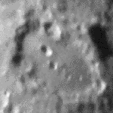
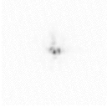
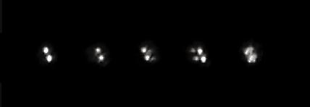
Images at High Magnification
Effect of seeing on images of the moon
Slow motion movie of what you see through a telescope when you look at a star at high magnification (negative images).
These photos show the double star Zeta Aquarii (which has a separation of 2 arcseconds) being messed up by atmospheric seeing, which varies from moment to moment. Alan Adler took these pictures during two minutes with his 8-inch Newtonian reflector.
Notes:
This shows different examples of how the atmosphere blurs images when you are looking at high magnification. So the atmosphere is a real factor that we need to take into account when we start to consider high magnification... and as long as we are on the subject...
The movie on the left shows how a star resolves then dissolves in the eyepiece due to atmospheric motion. This sequence, and the one at the bottom, carry a moral: be patient at the eyepiece – the atmosphere is constantly shifting, what you can’t see one moment you might see the next.
I like the lunar image, boiling like you’re seeing it through the heat coming off a road. This is normal atmospheric motion – seen in the world of high magnification.
Which incidentally brings up our next topic...

Slide 14
Ok so, Next Subject...
Magnification
Notes:
...I just had to do that.

Slide 15
Magnification
Make scope’s resolution big enough for the eye to see.
M: The apparent increase in size of an object when looking through the telescope, compared with viewing it directly.
f: The distance from the center of the lens (or mirror) to the point at which incoming light is brought to a focus.
Notes:
We will use “M” for magnification and “f” for focal length.

Slide 16
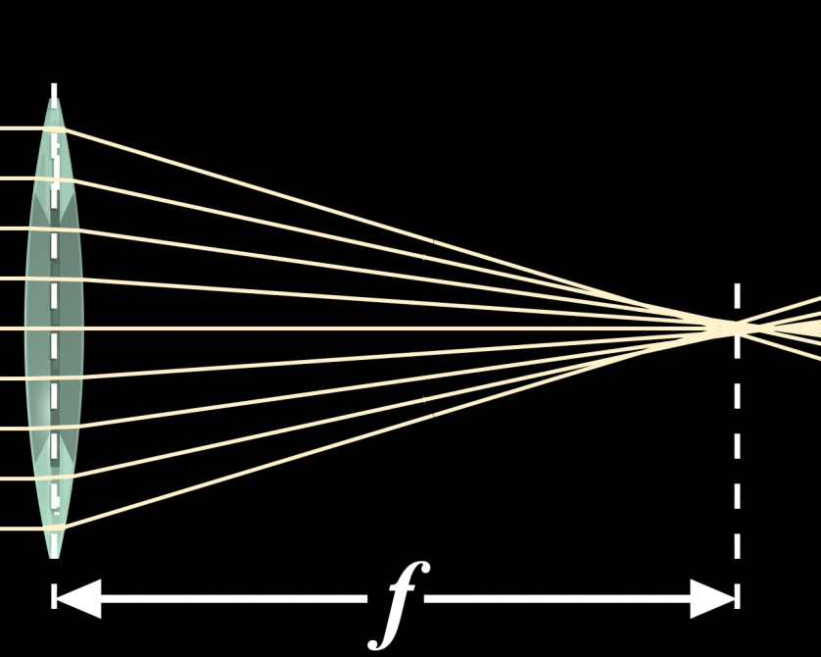
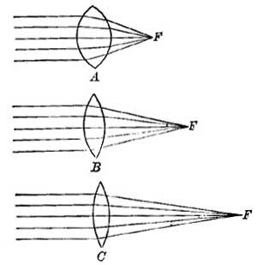
Focal Length
f_{O}: focal length of the objective
f_{e}: focal length of the eyepiece
Notes:
So f is the distance from the lens to the focal point
Fatter lenses (A) bend the light more, bring it to a point sooner and so have shorter focal lengths,
Skinnier lenses (B & C) bend the light less, so come to a focus farther out and have progressively longer focal lengths.
We will concern ourselves with two versions of “f” representing two focal lengths f_{O}: “O” for “objective”, and f_{e}: “e” for “eyepiece”.

Slide 17
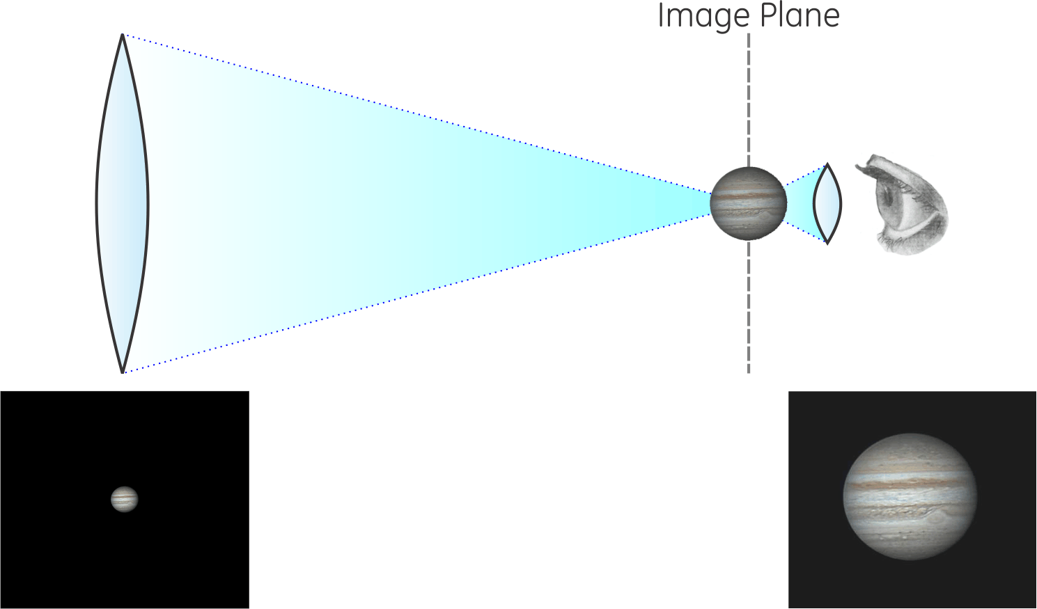
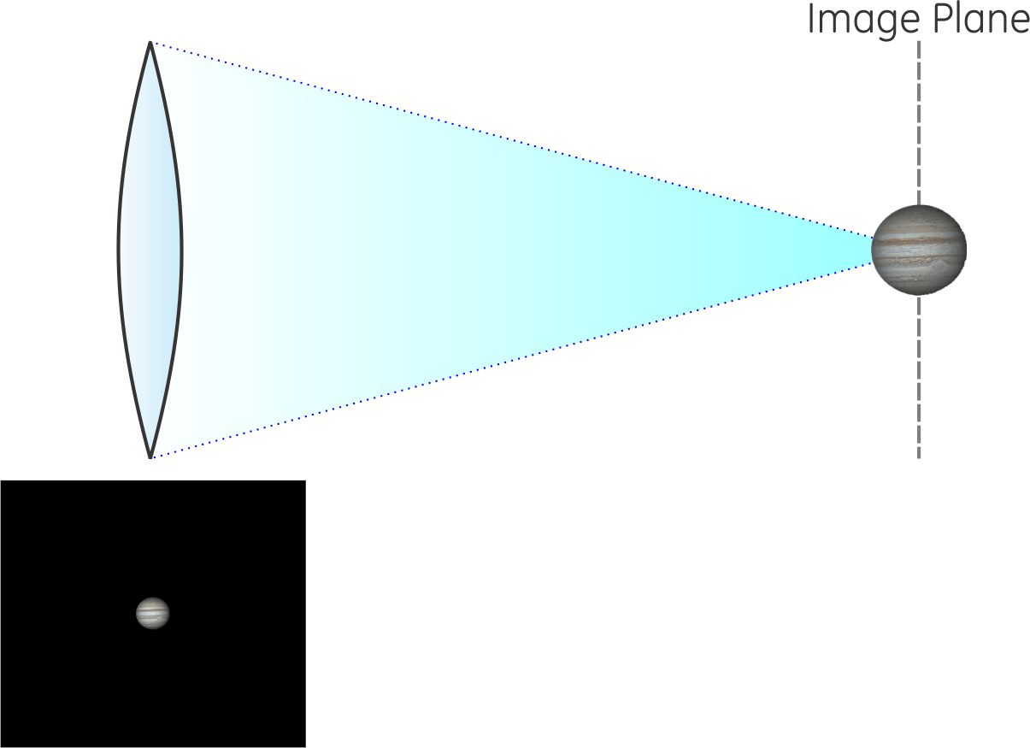
Magnification
Objective
Eyepiece
f_{e}
f_{O}
Notes:
What a telescope does to magnify the images is actually quite simple and intuitive.
The objective lens brings the image to a focus at its focal length. At that distance, the image looks the same as it does to your eye, that is, distance angles between stars are exactly the same as you see them when you look up. If two stars are one degree apart in the sky, they will be one degree apart at the image plane, as seen from the objective.
Then the eyepiece, with a much shorter focal length, lets you get very close to that image to look at it, and -- surprise -- when you get closer, the image is bigger. If the eyepiece lets you get twice as close, the image is twice as big. If the eyepiece lets you get 50 times closer, then the image is 50 times as big.
So the objective creates the image at a distance, then the eyepiece lets you see the image close up. Simple.

Slide 18

Magnification Formula
It’s simply the ratio:
$$\text{M}=\frac{{\text{f}}_{O}}{{\text{f}}_{e}}$$

Slide 19
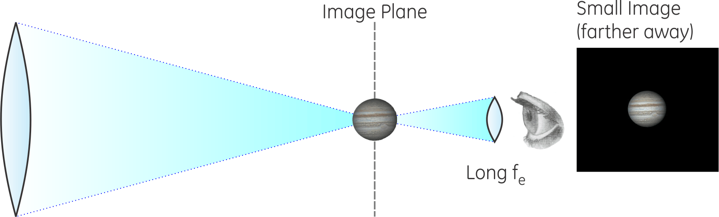
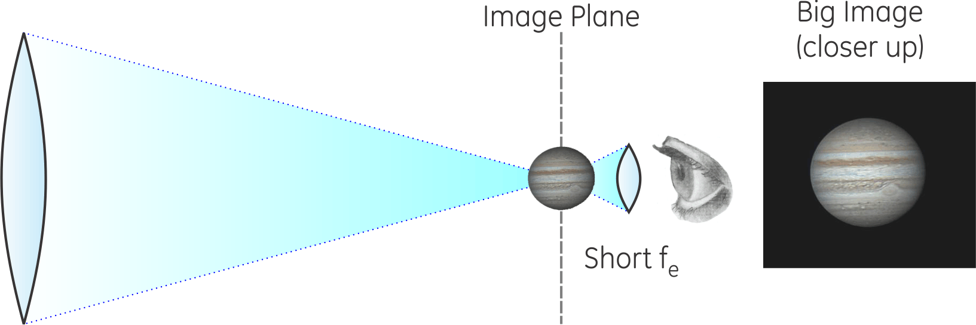
Effect of Eyepiece Focal Length
Objective
Eyepiece
Objective
Eyepiece
Notes:
The focal length of the objective is a fundamental property of the telescope.
We can control and change the eyepiece we are using. So the magnification of the telescope is determined by the focal length of the eyepiece we choose.
This is important: long fe eyepiece sets me back farther from the image plane – smaller image; short fe brings me close to the image plane – bigger image
Notice also when I get back farther away from the image I can see more of the sky, when I get closer in I’m seeing a smaller part of the sky.

Slide 20
Field of View
Manufacturer tells you the field of view (FOV) of the eyepiece
Typically 52°, wide angle can be 82°
Once you know it, then the scope FOV is quite simply
FOV_{e}
FOV_{scope} =
FOV
M
Notes:
If you hold up your eyepiece by itself and look through it, assuming you don't go cross-eyed trying, you will see that there is an upside-down image. The width of that image, measured as an angle, is the field of view of the eyepiece. Typically, an eyepiece has a field of view of 50-60°, although there are wide-field eyepieces that go up to as much as 82°.
When you expand the image by magnification, you can no longer see the whole field that you could see before magnification. So for example if you magnify the image by a factor of ten, you now can can only see one-tenth of the field you had without magnification.
So to find what the field of view will be in your telescope, first find the field of view of the eyepiece from its specifications, then divide by the magnification of your scope (with that eyepiece). Expressed as an equation this comes out to be FOV_{scope} = FOV_{e}/M.

Slide 21
Think You’ve Got It?
Armed with all this knowledge you are now dangerous.
Let’s try out what we just learned...

Slide 22
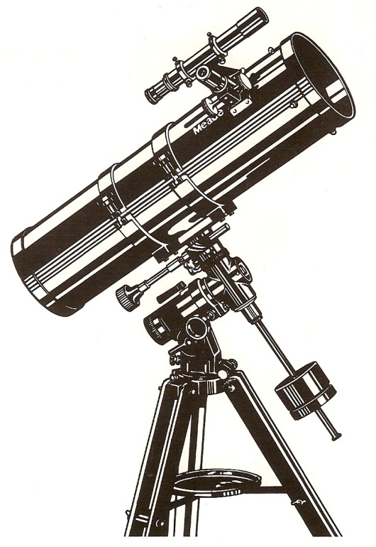
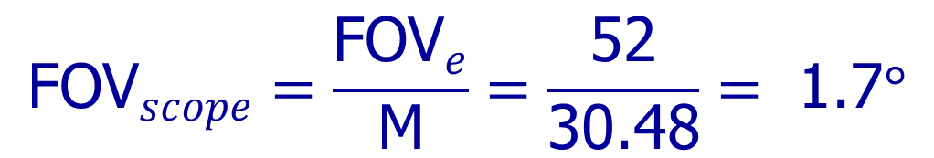
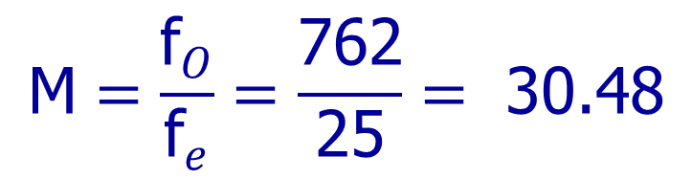
Magnification Example 1:
My 1st scope, a Meade 6600
  6” diameter, D_{O} = 152mm
  f_{O} = 762mm
  f_{e} = 25mm
  FOV_{e} = 52°
wooden tripod -
a real antique
$$\text{M}=\frac{{\text{f}}_{O}}{{\text{f}}_{e}}=\frac{\text{762}}{\text{25}}=\text{ 30.48}$$
$${\text{FOV}}_{scope}=\frac{{\text{FOV}}_{e}}{\text{M}}=\frac{\text{52}}{\text{30.48}}=\text{ 1.7}\text{°}$$
Notes:
Once you understand the principle, the calculation is pretty easy. Don't underestimate the importance of being able to find this number, though, it is fundamental to the determination of most other performance parameters of the telescope.
So let's try a couple of quick examples.
My first telescope was a Meade 6600 -- they don't make it any more -- it's a 6-inch f/5 Newtonian scope. It came with a 25mm eyepiece. So... what was the magnification I was getting with this scope?
Incidentally, notice how I characterize the scope and the eyepiece... the scope by its diameter and f-ratio, the eyepiece by its focal length. This is common parlance. It's also common to call out the scope diameter in inches, but for our purposes we will need to convert to mm. So the value we want for D_{O} is 6 × 25.4 = 152.4mm.
Wait a minute... the magnification is the focal length of the objective divided by the focal length of the eyepiece... so -- don't I need to tell you the focal length of the objective? Ah, but I have. Since the f-ratio is the focal length of the objective divided by the diameter of the objective, f_{R} = f_{O}/D_{O}, then the focal length of the objective is found from
f_{O} = D_{O}×f_{R} = 152.4 × 5 = 762 mm.
Then the magnification is f_{O}/f_{e} = 762/25 = 30.48, which we would just call 30.
The eyepiece has a field of view of 52°, so the field of view for the telescope at this magnification will be 52 ÷ 30 = 1.7°.

Slide 23
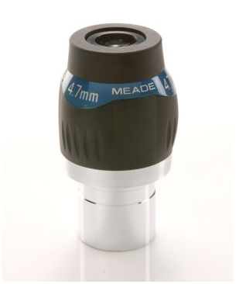
Magnification Example 2:
Dependence on Eyepiece
Eyepiece | Arithmetic | Magnification | Field of View
25 mm | 762 ÷ 25 = | 30 | 1.7°
15 mm | 762 ÷ 15 = | 50 | 1.0°
9 mm | 762 ÷ 9 = | 85 | 0.6°
4 mm | 762 ÷ 4 = | 190 | 0.3°
Notes:
Notice that, as the eyepiece focal length gets smaller, the magnification gets bigger. This is because I divide by the eyepiece focal length to get the magnification, so as I divide by a smaller and smaller number, the result gets bigger. In a more practical sense, though, a shorter focal length eyepiece means I get closer to the image produced by the objective, and as I get closer and closer to that image, it looks bigger and bigger.

Slide 24
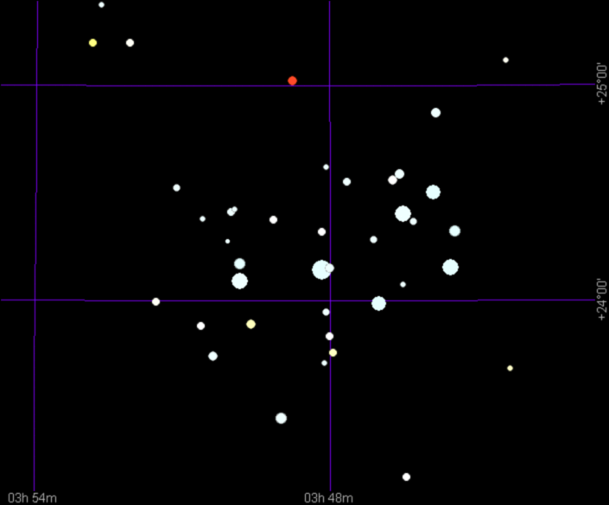
Magnification Example 3:
Let’s use the FOV to answer a question:
what eyepiece would I use if I want to
look at the Pleiades?
The Pleiades is a famous
(and beautiful) star cluster
in the constellation Taurus.
From a sky chart we can
see that the Pleiades is
about a degree high and
maybe 1.5° wide, so using
the preceding table, we
would pick the 25mm
eyepiece to see the entire
cluster at once.
Notes:
Similar problems present themselves routinely when looking for a specific target with the telescope: how large a field of view should I use for finding the target and for viewing the target? Sometimes it suffices to just wing it, other times it’s a good idea to give it a little thought up front and figure out what you will need in order to get everything in the scope view that you want to see.

Slide 25
Magnification Example 4:
I want to find the ring nebula in Lyra and I think my viewfinder is a bit off, so I may need to hunt around -- which eyepiece do I pick?
35mm
15mm
8mm
Notes:
This is more characteristic of the situation you are in when you are at the scope... you have 3 or four eyepieces to chose from and you need to decide which to use for what you want to do.

Slide 26
Magnification Example 5:
I want to be able to see the individual stars in the globular cluster M13 in Hercules. Which eyepiece do I pick?
35mm
15mm
8mm
Notes:
Ok let’s try another one...

Slide 27
Maximum Magnification
What’s the biggest I can make it?
Notes:
Ok now we come to the cool part. You will be shocked and amazed.

Slide 28
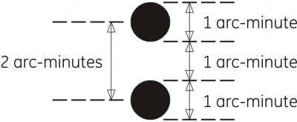
What the Eye Can See
The eye sees features 1 arc-minute (60 arc-seconds) across
Stars need to be 2 arc-minutes (120 arc-sec) apart, with a 1 arc-minute gap, to be seen by the eye.
Notes:
A point of light appears to the eye to be a tiny disk one arc-minute across, because that’s the smallest feature the eye can see.
This is the same principle on which the Snelling diagram – the doctor’s eye chart – is based. The lines and gaps, like in the letter E, on the 20/20 line are exactly 1 arc-minute thick, is what a 20/20 eye can just resolve.

Slide 29
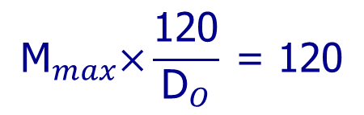
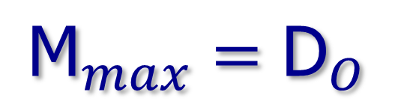
Maximum Magnification
The smallest separation the scope can see is its resolving power P_{R}
The scope’s smallest detail must be magnified by M_{max} to what the eye can see: 120 arc-sec.
Then M_{max}×P_{R} = 120; and since P_{R} = 120/D_{O},
$${\text{M}}_{max}\text{×}\frac{\text{120}}{{\text{D}}_{O}} \text{= 120}$$
which reduces (quickly) to
$${\text{M}}_{max}={\text{D}}_{O}$$
Wow. Not a difficult calculation
Notes:
Multiply the scope’s smallest separation to what the eye can see... if I go bigger than that, there is no new detail, so I will call that my maximum magnification M_{max}.
What this is saying is that the maximum magnification of the scope is equal to the diameter of the scope in millimeters.
If I know the diameter of the scope I know the maximum magnification -- they’re the same thing!!!!
This very convenient coincidence – that your eye resolves 120 arc-sec separation and the resolving power of the scope is 120/D_{O}, comes from the fact that we measured D_{O} in mm. That is convenient indeed, since scope diameters are usually (not always) printed right on the scope in mm.
It is unlikely you will see this mentioned in text books, for what reason I cannot imagine, but you might see that it is 25 times the scope diameter in inches, or 10 times the scope diameter in centimeters... I’ve never seen someone point out that it simply IS the scope diameter in mm.
========================================
The Dawes Limit determines the smallest separation between two stars that the telescope can resolve, as described in the page on Resolving Power. Then for a person to see that separation, the telescope needs to magnify the separation to one the eye can resolve, which is 2 minutes of arc, or 120 arc-seconds.
So then the algebra gives you the remarkable result that M_{max} = D_{O}.
Wow. Do you see what this is saying? The maximum magnification of the telescope can be found by just looking at the diameter of the scope in mm. So if I look at the front of an 8-inch scope where it says "D=203mm", I know the maximum magnification is 203. I look at the front of my ETX where it says "D=90mm", I know the max magnification for my ETX is 90. I look at my Meade 6600 6-inch scope where it says "D=152mm" and I know the maximum magnification for that scope is 152.
This is very handy to know.
CAUTION - telescope manufacturers often advertise the magnification of a scope, and give big, impressive numbers. Since you should be able to change the magnification by changing the eyepiece, this number is meaningless. It is possible to use a very short focal length eyepiece and set the magnification of the scope way beyond it's capability so what you see is just a big, (faint) blurry image.
The important measure of a telescope is the diameter of the objective, not "the magnification".

Slide 30
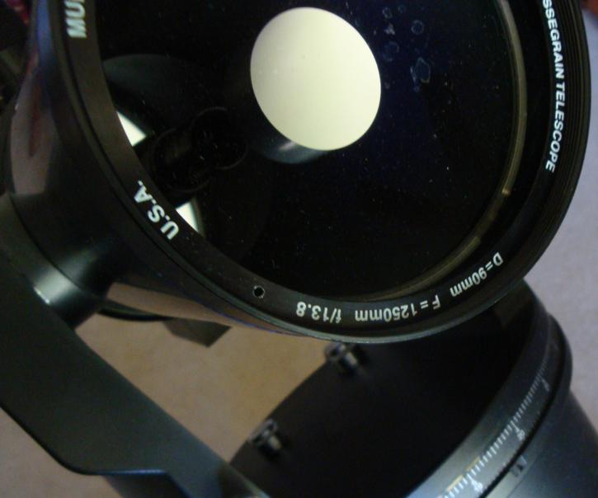
Max Magnification Example 1:
This scope has a
max magnification
of 90
Notes:
You can usually read it right off the scope.

Slide 31
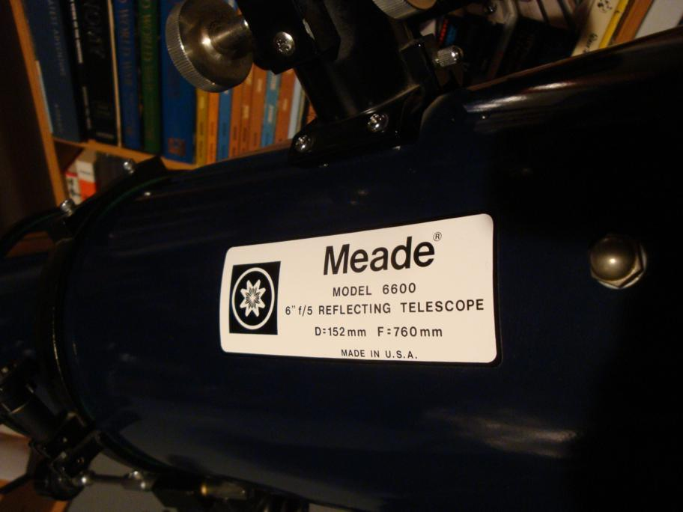
Max Magnification Example 2:
This scope has a max magnification of 152.

Slide 32
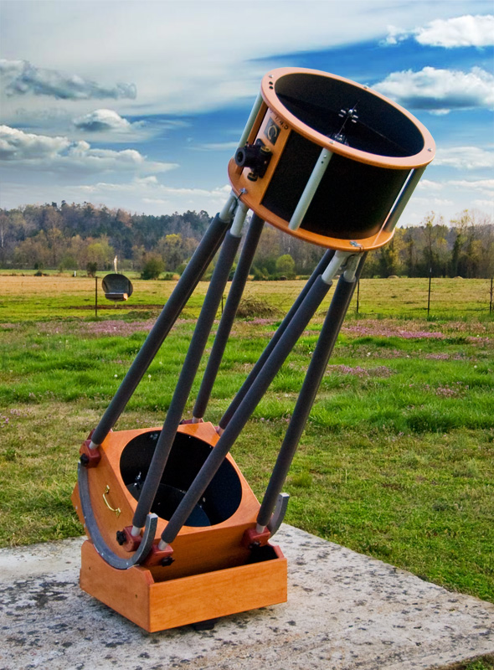
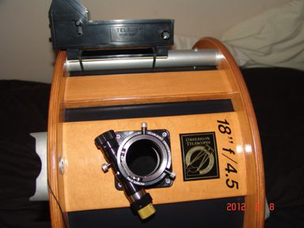
Max Magnification Example 3:
We have to convert:
18”×25.4 = 457.2mm
This scope has a max magnification of 457.
Notes:
If the scope diameter is not given in mm, you may actually have to do some arithmetic.
Say, and what’s that “f/4.5” thing doing there?

Slide 33
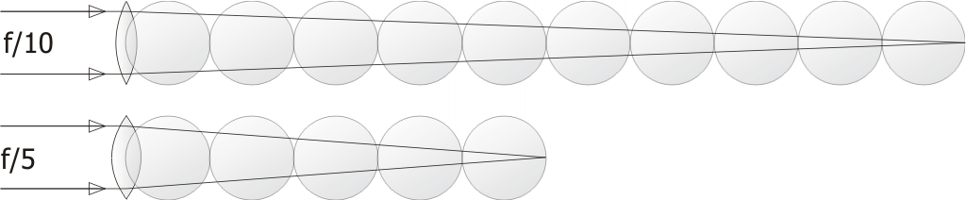
f-Ratio
Ratio of lens focal length to its diameter.
i.e. Number of diameters from lens to focal point
f_{O}
f_{R} =
D_{O}
Notes:
Well, “f/”-something is telling you the f-ratio of the scope.
Lucky that came up – or some of you might suspect it wasn’t just luck – because you should be wondering how I figure out the eyepiece to get the maximum magnification, which of course you can calculate, but it turns out... no calculation required at all, you already have it.

Slide 34
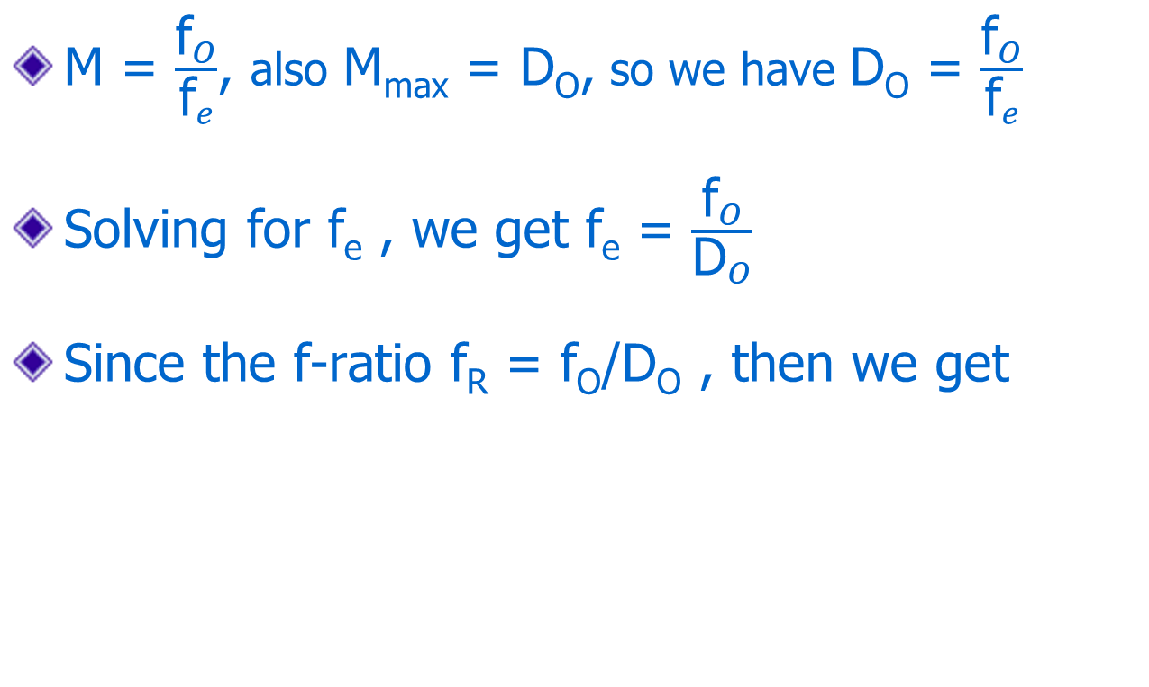
Eyepiece for Max Magnification
M = $\frac{{\text{f}}_{O}}{{\text{f}}_{e}}$, also M_{max} = D_{O}, so we have D_{O} = $\frac{{\text{f}}_{O}}{{\text{f}}_{e}}$
Solving for f_{e} , we get f_{e} = $\frac{{\text{f}}_{O}}{{\text{D}}_{O}}$
Since the f-ratio f_{R} = f_{O}/D_{O} , then we get
f_{e-min} = f_{R}
Wow. Also not a difficult calculation
Notes:
We’re going for max magnification so that means the closest that it makes sense to get to the image plane, therefore it’s the shortest fe. I’m going to call it fe-min.
Since magnification is f_{O}/f_{e}, then M_{max} is f_{O}/f_{e-min}, and we just figured out that M_{max} = D_{O}, so that gives us D_{O} = f_{O}/f_{e-min}
Rearranging to solve for f_{e-min} gets us f_{O}/D_{O}... wait a minute didn’t we just see that someplace? Oh, right it’s the f-ratio
HOLY SMOKES the eyepiece for max magnification is just the f-ratio. I can read that one right off the scope, too!!!
=========================================================================
The eyepiece is equally easy to figure out. From the equation for magnification we have M = f_{O}/f_{e}, and we want the value of f_{e-min} to get us to M_{max} = D_{O} so then D_{O} = f_{O}/f_{e-min}, and therefore f_{e-min}=f_{O}/D_{O}.
Since the f-ratio f_{R}=f_{O}/D_{O} then we have, quite simply, f_{e-min} = f_{R}
Wow. Do you see what this is saying? The eyepiece focal length to get the maximum magnification can be found by just looking at the f-ratio for the scope! So if I look at the front of an 8-inch scope where it says "f/10", I know the smallest eyepiece I can use with that scope is a 10mm eyepiece. I look at the front of my ETX where it says "f/13.8", I know the smallest eyepiece for my ETX is 14mm. I look at my Meade 6600 6-inch scope where it says "f/5" and I know the smallest eyepiece focal length to use with it is 5mm.
This is also very handy to know.
By the way you can confirm this for yourself... on a clear night, looking at a bright star in your telescope, use an eyepiece with a focal length in mm that matches the f-ratio and you will clearly see the rings of the Airy disk, telling you that you are operating at limit of the scope's resolution.

Slide 35
Max Mag Eyepiece Example 1:
Max magnification
of 90 is obtained
with 14mm
eyepiece

Slide 36
Max Mag Eyepiece Example 2:
Max magnification of 152 is achieved
with a 5mm eyepiece.
Notes:
So my 6” scope, which had only a 30x power with a 25mm eyepiece, can go to a much higher power, using a much shorter focal-length eyepiece, than the 3.5” ETX. I can use the 5mm eyepiece in the ETX but I will clearly see that I am way beyond the capacity of the scope.

Slide 37


Max Mag Eyepiece Example 3:
18” = 457mm
Max magnification of 457 is achieved with a 4.5mm eyepiece.

Slide 38
How Maximum is Maximum?
M_{max} = D_{O} is the magnification that lets you just see the finest detail the scope can show.
You can increase M to make detail easier to see... at a cost in fuzzy images (and brightness)
Testing your scope @ M_{max}: clear night, bright star – you should be able to see Airy Disk & rings
‒ shows good optics and scope alignment
These reasons for higher magnification might make sense on small scopes, on clear nights... when the atmosphere does not limit you...
Notes:
...so there are a couple reasons to increase M beyond Mmax... on small scopes, on clear nights... when the atmosphere is not limiting you...
========================================================
If you compare manufacturer's specifications for maximum magnification to the limit I give here, you'll find their number is often higher -- sometimes 2 or 3 times as high! Does this mean the manufacturers are full of baloney?
Well, actually, no. Well, some of them are, but for the most part, no. It's true that once you get to the magnification M_{max} = D_{O}, then going to higher magnification shows you no additional detail, however -- sometimes making the image a little bit bigger can make the detail a little easier to see. It really depends on the image.
For instance, in my ETX, with a calculated maximum magnification of 90, I find that the binary star γ (gamma) Leonis looks best at 90x, but the binary star Castor looks marginally better at 140x. The separation's about the same, although Castor is quite a bit brighter, so the dimming effect of higher magnification helps to see the separation. When I look at Saturn, it looks a little bit better at 140x (not entirely sure why), whereas Mars is definitely better at 90x.
So the moral of the story is that, once you find the maximum magnification, and the eyepiece focal length that gets it, you can probably go to the next size smaller eyepiece as well, and it will come in handy from time to time. It usually depends on whether you have brightness to spare.

Slide 39
That Air Again...
On a good night, the atmosphere permits 1 arc-sec resolution
To raise that to what the eye can see (120 arc-sec) need magnification of... 120.
Extremely good seeing would be 0.5 arc-sec, which would permit M = 240 with a 240mm (10”) scope.
In practical terms, the atmosphere will start to limit you at magnifications around 150-200
We must take this in account when finding the telescope’s operating points.
The real performance improvement with big scopes is brightness... so let’s get to Part 2...
Notes:
This limit of 200x needs to be accounted for when figuring the operating points of the scope.
So remember we said the max magnification for the Obsession 18” scopes is 457? Ah... not on this planet.

Slide 40
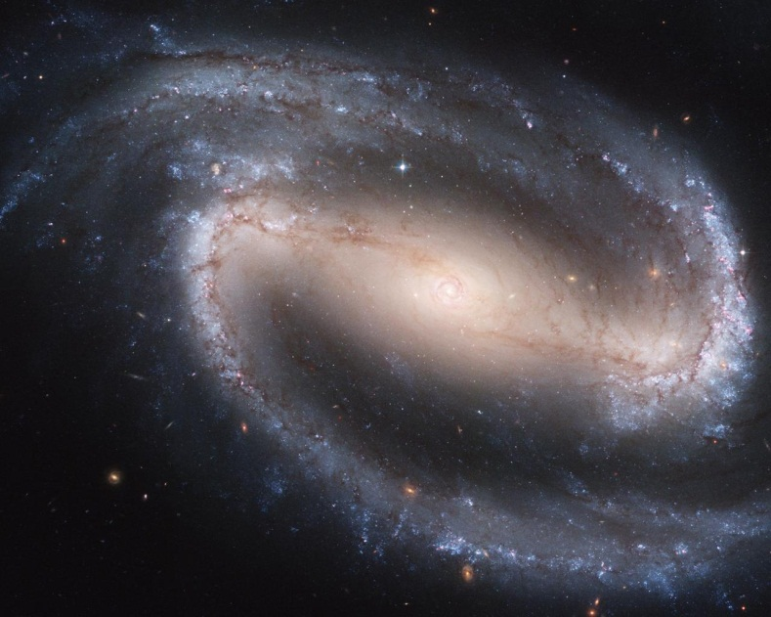
Part 2: Telescope Brightness
Notes:
That’s right... there’s more! We’re just getting warmed up...
So to understand the cost in scope brightness, lets take a look at the factors that affect brightness, including the magnification at which we are operating.

Slide 41
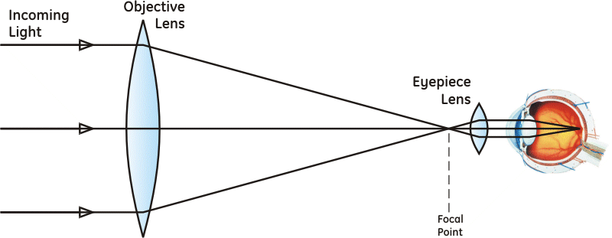
Light Collection
Larger area ⇒ more light collected
Collect more light ⇒ see fainter stars
Notes:
For you to see a star, the light from the star has to get into your eye, and it gets in through the pupil. So the larger the pupil, the more light gets in, and the fainter are stars your eye can detect. While everyone is different, typically the pupil of the eye, when it is adapted to the dark, is about 7 mm in diameter.
What the telescope does is to collect light over a much wider area than just the 7mm of your eye pupil. It then focuses that light down to the size of your eye pupil so you end up with much more light passing into your eye. This enables you to see much fainter stars with a telescope than you could without.

Slide 42
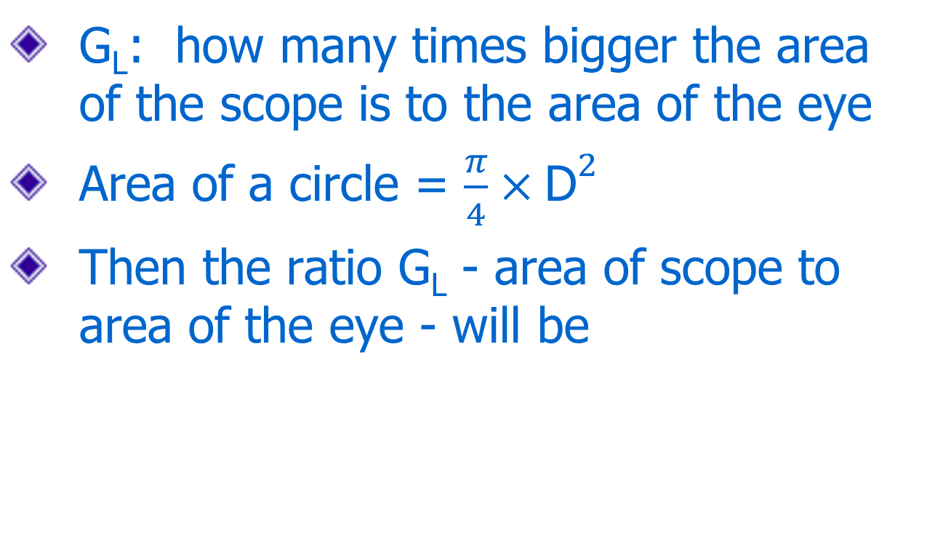
Light Grasp
G_{L}: how many times bigger the area of the scope is to the area of the eye
Area of a circle = $\frac{π}{4}×{\text{D}}^{2}$
Then the ratio G_{L} - area of scope to area of the eye - will be
Notes:
How much more light does the telescope collect? That is known as the "light grasp", and can be found quite simply as the increase in area that you gain in going from using the pupil of your eye to using the objective lens (or mirror) of the telescope.
The area of a circle is found as π/₄ × D²
So the light grasp -- we'll call it G_{L} -- is the ratio of the area of the objective to the area of the pupil of the eye, which is the equation shown.
This is fine, but it doesn’t really tell me what I want to know... how much fainter are the stars I can see in the scope?
Well star brightness and faintness are defined in terms of star magnitudes...

Slide 43
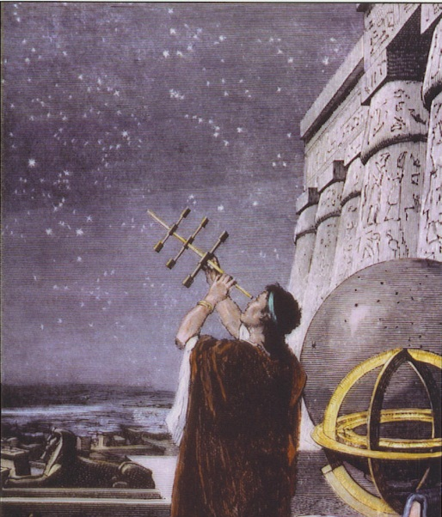
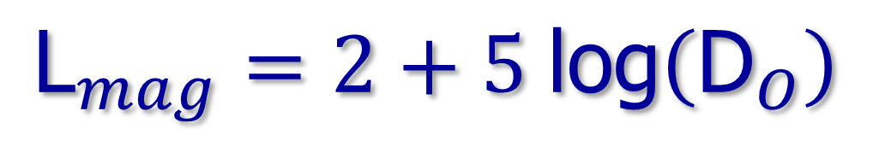
Star Brightness & Magnitudes
Ancient Greek System
  Brightest: 1st magnitude
  Faintest: 6th magnitude
Modern System
  Log scale fitted to the Greek system
  With G_{L} translated to the log scale, we get
$${\text{L}}_{mag}=2+5 \text{log}\left({\text{D}}_{O}\right)$$
L_{mag} = magnitude limit: the faintest star visible in scope
Notes:
Hellenic system from the Greeks
Modern system fits a logarithm scale to the ancient Greek system so the magnitude can now be calculated based on the measured brightness of the star.
When we translate the light grasp of the telescope into the terms of the logarithm scale for magnitudes, we can calculate the magnitude of the faintest star that can be seen with the scope.
=========================================================
Astronomers measure star brightness using "magnitudes". The magnitude scale originates from a system originally set up by ancient Greeks, where the brightest stars were stars of the first magnitude, like 'first class', and the faintest stars you could see were stars of the sixth magnitude.
When astronomers got telescopes and instruments that could measure star brightness, they found 1st magnitude stars were almost exactly 100 times the brightness of 6th magnitude stars. That works out to a factor of 2½ from one magnitude to the next. This is a relative scale, with stars like Capella, Vega, and Arcturus establishing the zero point. (Incidentally, the scale does go negative -- Sirius, for example, is magnitude -1.5)
The actual formula for finding magnitude is logarithmic because you are translating multiplying factors into a linear scale. So to find a magnitude difference I take the ratio of one brightness to another, then I take the logarithm of that ratio, then I multiply by 2.5.
Why do I multiply by 2.5? Remember that I said that a difference of 5 magnitudes (from 1 to 6) represents a brightness factor of 100. If I take the logarithm of 100 I get 2 (10² =100) so I need to multiply by 2.5 to turn that into a difference of 5 on the magnitude scale. The logic really is that simple.
So if I call the first brightness I₁ and the second brightness I₂ -- "I" is for "intensity" -- then the formula for the magnitude difference of I₂ over I₁ is
Magnitude Difference = 2.5 × log(I₂/I₁).
Not so hard, really.
From the formula for G_{L} we get magnitude gain = 2.5×log(G_{L}) = 2.5×log((D_{O}/D_{eye})^2) = 5×log(D_{O}/D_{eye}) = 5×log(D_{O}) - 5×log(D_{eye}) Now if we assume D_{eye} = 7 then 5×log(D_{eye}) = 4.2. So magnitude gain from the telescope is then G_{mag} = 5×log(D_{O}) – 4.2. Since the magnitude limit for seeing with just your eye is about magnitude 6, then adding the scope gain to that, you get the magnitude limit with the telescope is 6 + 5×log(D_{O}) – 4.2, and since this is approximate (depends on sky conditions and your eye), the formula for the magnitude limit with the scope simplifies to L_{mag} = 2 + 5×log(D_{O}).

Slide 44
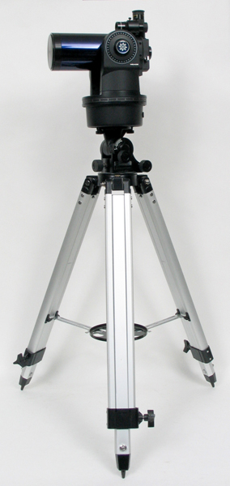
Example 1: Which Scope?
Asteroid Pallas in Cetus this month at magnitude 8.3
Can my 90 mm ETX see it
or do I need to haul out
the big (heavy) 8” scope?
L_{mag} = 2 + 5 log(90) = 2 + 5×1.95
= 11.75
Should be easy for the ETX. The magnitude limit formula has saved my back.
Notes:
You may be surprised to learn that I personally don’t have a 40m scope, or even a 30m scope. I have a 90_{mm} ETX and an 8” scope that is plenty heavy enough.
I want to go out tonight and find the asteroid Pallas, which is wandering through Cetus at magnitude 8.3 as I speak. It's just that I don't want to lug my heavy scope out if I can grab my smaller scope (which sits right by the front door at all times) and spot it with that. So the question is -- can I see Pallas with my 90mm ETX?
I apply the magnitude limit formula for the 90mm ETX, in the hopes that the gain will get me to better than magnitude 8.3. So the magnitude limit for this scope is Lmag = 2+5*log(90) = 2 + 5*1.95 = 11.75. Should be an easy target for this scope.
Where I use this formula the most is when I am searching for a deep sky object and want to see how the star field will look in the eyepiece. I can do that by setting my astronomy software to show star magnitudes down to the same magnitude I will be able to see in the telescope.
From my calculation above, I set the magnitude limit for "faintest" stars to 9.5 and the software shows me the star field I will see in the eyepiece. This helps me to identify the asteroid as the "star" that isn't supposed to be there.
Let's suppose I need to see what the field will look like through the viewfinder scope, so I want to find the limiting magnitude for the viewfinder. Written right on my viewfinder it says "8x25mm", so the objective of the viewfinder is 25mm, and the magnitude gain is 5 × log(25/7) = 2.8. So I would set the star magnitude limit to 6.8 and the software shows me the star field that I will see through the viewfinder.

Slide 45
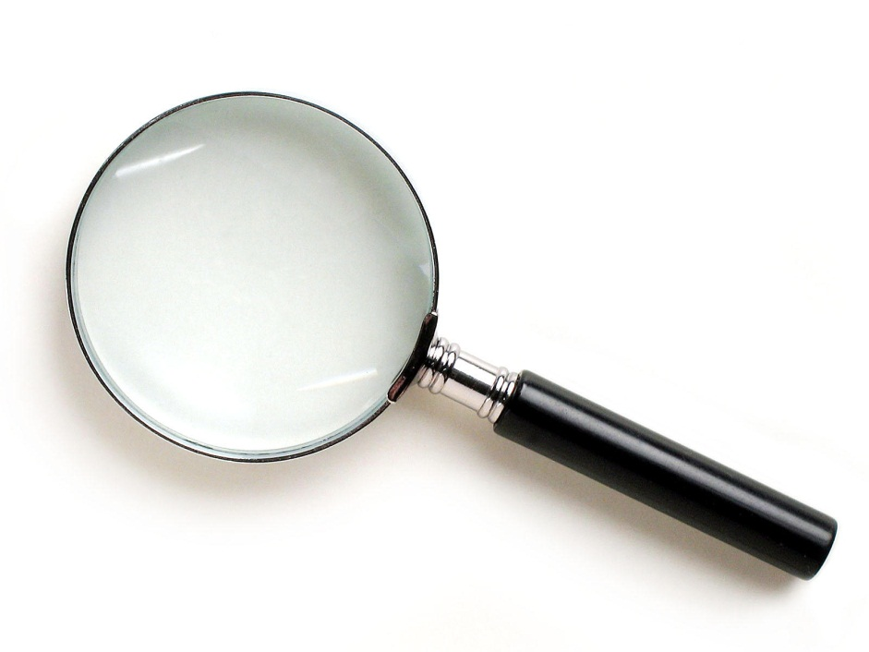
Magnification & Brightness

Slide 46
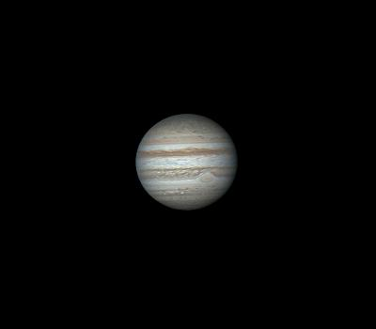
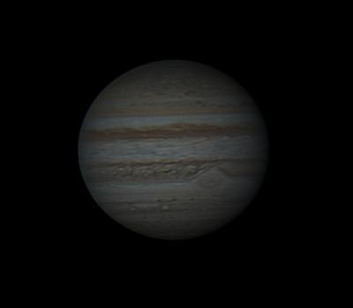
Brightness is tied to magnification...
Low Magnification
High Magnification
Notes:
Telescopes don’t work like computers. On a computer I can zoom in on an image and it stays the same brightness. That won’t happen on a telescope. When I increase the magnification on a telescope, the image gets markedly less bright – in fact I’ve understated the effect in this slide. If I have a zoom eyepiece on the telescope this magnification dimming effect is very easy to see, if perhaps a little disturbing. What the heck is going on??
If I look first at 30 power, I can then change the eyepiece out for one with half the focal length and double the power to 60x.
Jupiter will then be twice the diameter in my image, and since area is a function of the diameter squared (area = ^{π}/₄×D²), then when I double the diameter of Jupiter I multiply the area by 2² = 4.
The telescope is still collecting the same light, which is now spread out over 4 times the area.
It’s the same light, so the same total brightness, but obviously dimmer because the light has been thinned out over a larger area. This “brightness per unit area” is called surface brightness. It doesn’t apply to stars because they are points of light, they don’t have an area. But for planets, nebulae, galaxies... anything that has a size, this is very important.

Slide 47
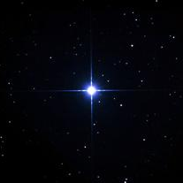
Stars Are Immune
Stars are points: magnify a point, it’s still just a point
So... all the light stays inside the point
Increased magnification causes the background skyglow to dim down
I can improve contrast with stars by increasing magnification...
...as long as I stay below M_{max}...
Stars like magnification
Galaxies and Nebulas do not
Notes:
Stars are points. If I magnify a star, it’s still a point. Stars and other “point” objects (e.g. asteroids) are therefore NOT affected by magnification dimming
So then – when is a star no longer a point? When I exceed max magnification & it becomes an Airy disk – an “area” object that fades with magnification.
What happens when the magnification goes way past maximum? Stars fade like everything else... faint stars disappear.

Slide 48
The Exit Pupil
Magnification
Surface brightness
Limited by the exit pupil
Exit Pupil
Notes:
The increase in brightness as you reduce magnification has a limit, and that limit is related to something called the exit pupil.
The “exit pupil” is the diameter of the cylinder of light coming out of the eyepiece, as shown in the diagram above.
It turns out this represents the operating point of the telescope in surprisingly useful ways, so let’s take a closer look at the exit pupil

Slide 49


Exit Pupil Formulas
$${\text{D}}_{ep}=\frac{{\text{D}}_{O}}{\text{M}}$$
Scope Diameter & Magnification
$${\text{D}}_{ep}=\frac{{\text{f}}_{e}}{{\text{f}}_{R}}$$
Eyepiece and
f-Ratio
Notes:
There are two ways to find the exit pupil: scope diameter to magnification, and eyepiece to f-ratio.
These two equations are simple and easy to work with, and as you will see, they are awesome general problem-solvers.
You’ve been spared the derivation of these equations but if you want to see it I’m more than happy to show you... I spent hours getting that slide just right, only to relegate it to the scrapheap of the appendix.

Slide 50

Exit Pupil Tracks Scope FOV
Both depend on magnification
As magnification gets bigger, both get smaller
Exit pupil gets smaller, FOV gets smaller, so you see a smaller part of the picture... in fact:
The size of the exit pupil shows how much of the picture from the scope goes in the eye.
$${\text{D}}_{ep}=\frac{{\text{D}}_{O}}{\text{M}}$$
FOV_{e}
FOV_{scope} =
M
Notes:
...and how much of the picture from the scope equates to how much of the total light from the scope is going into the eye.

Slide 51

Exit Pupil at High Magnification
High magnification, small scope FOV, small exit pupil
Notes:
So at high magnification, we have a small field of view, which means a small portion of the light from the scope, coming into the eye through a small exit pupil.

Slide 52
Exit Pupil at Low Magnification
Low magnification, large scope FOV, large exit pupil
Notes:
And at lower magnification, we have a larger field of view, which means more of the light from the scope, and it’s coming into the eye through a larger exit pupil.

Slide 53
What Happens Now?
Magnification so low, exit pupil is BIGGER than eye pupil
Notes:
What happens if I keep reducing the magnification to make the image brighter, and I end up making the exit pupil bigger than your eye pupil?
Well then the additional light from the scope simply cannot enter the eye.
Everything outside that red circle, the additional light that would have made the image brighter, is lost.
Once the exit pupil reaches the size of your eye pupil, that’s the brightest the image will get.
As magnification is reduced further, the image gets smaller but NO BRIGHTER.

Slide 54


Minimum Magnification
Magnification
$${\text{D}}_{ep}=\frac{{\text{D}}_{O}}{\text{M}}$$
$$\text{M}=\frac{{\text{D}}_{O}}{{\text{D}}_{ep}}$$
Below the magnification where D_{ep} = D_{eye} = 7mm, image gets smaller, brightness is the same.
$${\text{M}}_{min}=\frac{{\text{D}}_{O}}{{\text{D}}_{ep}}=\frac{{\text{D}}_{O}}{{\text{D}}_{eye}}=\frac{{\text{D}}_{O}}{\text{7}}$$
Notes:
So the maximum surface brightness I can achieve is when the exit pupil has grown to just match the eye pupil, which is about 7 mm when your eye is adapted to the dark.
The magnification to get this maximum exit pupil is my minimum magnification. Then if I use the first formula for the exit pupil, and rearrange it a bit, I can find the minimum magnification, M_{min} as D_{O}/7.
Because I don't get any increase in brightness past this point, and I only make the image smaller, there isn't really much point in going with a magnification that's any lower than this.
The calculation to show the surface brightness never gets brighter than at M_min goes like this:
Assume we are at M_min, and D_ep = D_eye, and the area of our distributed object is A_0.
We now decrease M to be M_min/c, where c>1.
Then D_ep = c*D_eye.
The area of the distributed object is now A_1 = A_0/c², so the surface brightness will be A_0/A_1 = c² times the original.
Fraction of area of the exit pupil the eye sees is D_eye²/D_ep², or D_eye²/(c*D_eye)² = 1/c².
So the brightness of the distributed object is c²*(1/c²) = 1*original brightness

Slide 55


Max Eyepiece Focal Length
Eyepiece
$${\text{D}}_{ep}=\frac{{\text{f}}_{e}}{{\text{f}}_{R}}$$
$${\text{f}}_{e}={\text{D}}_{ep}×{\text{f}}_{R}$$
At minimum magnification Dep = 7mm, so the maximum eyepiece focal length is
f_{e-max} = 7×f_{R}
Notes:
Once we know the magnification we want, we can determine the eyepiece to get it. That comes from the exit pupil formula for finding the eyepiece focal length.
The surprise in this result is that the maximum focal length eyepiece depends only on the f-ratio of my scope.

Slide 56


Example 1: Min Magnification
My Orion SkyView Pro 8
  8” diameter
  f/5
D_{O} = 25.4×8 = 203.2mm
$${\text{M}}_{min}=\frac{{\text{D}}_{O}}{\text{7}}=\frac{\text{203.2}}{\text{7}}\text{= 29}$$
f_{e-max} = 7×5 = 35mm
simple
Notes:
Just look at how cool these results are. If I know the diameter of the objective and the f-ratio of the scope, I can immediately identify the largest eyepiece focal length and smallest magnification that gives me the brightest image.
So for example, take my brand-spanking new 8-inch, f/5 scope. Converting the diameter to metric, I have 8 × 25.4 = 203mm, so the minimum magnification is D_{O} ÷ 7 = 203 ÷ 7 = 29.
Even easier is finding the brightest eyepiece, or f_{e-max}, which is just 7 × f_{R} = 7 × 5 = 35mm.
Since I’m an old fart with likely no better than a 6mm pupil fully dilated, I opted for an M_{min}= 203÷6=33 and an f_{e-max}=6×5=30mm (wide-angle).
Let's take a look at how this works out for my other scope, a 90mm f/13.9 ETX.
The minimum magnification is D_{O} ÷ 7 = 90 ÷ 7 = 13.
Gee, it seems like for a telescope that's less than awesome, especially since my 10x50 binoculars just about match that in magnification.
Well, then, let's look at the maximum eyepiece focal length for this scope. f_{e-max} = 7 × f_{R} = 7 × 13.9 = 97.3mm.
Jumpin' Jehosephat! I don't think I could even find an eyepiece with a focal length like that. (That's right, try as you might you won't find an eyepiece that big.) Which is ok, I didn't want that magnification anyway.
So why would I want to know the max eyepiece for this scope? In fact, the minimum magnification and maximum eyepiece are essential for you to determine how bright your scope image will be, which we will get to in a minute, but first let’s take a look at how these two special cases compare.

Slide 57


Example 2: Min Magnification
Zemlock (Z1) Telescope
  25” diameter
  f/15
D_{O} = 25.4×25 = 635mm
$${\text{M}}_{min}=\frac{{\text{D}}_{O}}{\text{7}}=\frac{\text{635}}{\text{7}}\text{= 90.7}$$
f_{e-max} = 7×15 = 105mm
oops
What happens when we get an impossibly big answer?
Well, then, maximum brightness is simply impossible.
Notes:
Just look at how cool these results are. If I know the diameter of the objective and the f-ratio of the scope, I can immediately identify the largest eyepiece focal length and smallest magnification that gives me the brightest image.
So for example, take my brand-spanking new 8-inch, f/5 scope. Converting the diameter to metric, I have 8 × 25.4 = 203mm, so the minimum magnification is D_{O} ÷ 7 = 203 ÷ 7 = 29.
Even easier is finding the brightest eyepiece, or f_{e-max}, which is just 7 × f_{R} = 7 × 5 = 35mm.
Since I’m an old fart with likely no better than a 6mm pupil fully dilated, I opted for an M_{min}= 203÷6=33 and an f_{e-max}=6×5=30mm (wide-angle).
Let's take a look at how this works out for my other scope, a 90mm f/13.9 ETX.
The minimum magnification is D_{O} ÷ 7 = 90 ÷ 7 = 13.
Gee, it seems like for a telescope that's less than awesome, especially since my 10x50 binoculars just about match that in magnification.
Well, then, let's look at the maximum eyepiece focal length for this scope. f_{e-max} = 7 × f_{R} = 7 × 13.9 = 97.3mm.
Jumpin' Jehosephat! I don't think I could even find an eyepiece with a focal length like that. (That's right, try as you might you won't find an eyepiece that big.) Which is ok, I didn't want that magnification anyway.
So why would I want to know the max eyepiece for this scope? In fact, the minimum magnification and maximum eyepiece are essential for you to determine how bright your scope image will be, which we will get to in a minute, but first let’s take a look at how these two special cases compare.

Slide 58
Example 3: Eyepiece Ranges
f-ratio | f_{e-min} | f_{e-max}
4 | 4 | 28
4.5 | 4.5 | 31.5
5 | 5 | 35
6 | 6 | 42
8 | 8 | 56
10 | 10 | 70
15 | 15 | 105
Limited
by
eyepiece
Notes:
As you get to long f-ratios, you need longer and longer eyepiece focal lengths to get a bright image.
Beyond f/8, you simply can’t get to the highest brightness.
In that case you go with the longest eyepiece you can get and see where that puts you on the performance curve. I’ll show you how to do that next.
These scopes are great for photography, where long exposures will compensate for lower brightness, and the key performance is high magnification and perfectly uniform optics.
Getting to maximum magnification is less of a challenge, and can be achieved with pretty much any f-ratio. Getting much past maximum magnification (even shorter – or closer – eyepiece focal lengths) will be tough, though, with low f-ratio scopes.

Slide 59
Surface Brightness
This next thing you are simply not going to believe.
That’s ok. I didn’t believe it the first time I heard it either.
So here comes the math, because otherwise you just
Totally Won’t Believe Me

Slide 60

In Search of Surface Brightness
Scope image is brighter than your eye’s image by a factor we called light grasp G_{L}
That light must be spread out – dimmed down – by the minimum magnification M_{min} (dimmed by M_{min}²)
So: ${\text{SB}}_{scope}={\text{SB}}_{eye}×\frac{{\text{G}}_{L}}{{{\text{M}}_{min}}^{2}}$
Notes:
So... buzz buzz buzz hand-wave hand-wave...

Slide 61



Maximum Surface Brightness
$${\text{G}}_{L}={\left(\frac{{\text{D}}_{O}}{{\text{D}}_{eye}}\right)}^{2}$$
$${\text{M}}_{min}=\frac{{\text{D}}_{O}}{{\text{D}}_{eye}}$$
$${\text{SB}}_{scope}={\text{SB}}_{eye}×\frac{{\text{G}}_{L}}{{{\text{M}}_{min}}^{2}}={\text{SB}}_{eye}×\frac{{\left({{\text{D}}_{O}}/{{\text{D}}_{eye}}\right)}^{2}}{{\left({{\text{D}}_{O}}/{{\text{D}}_{eye}}\right)}^{2}}= {\text{SB}}_{eye}$$
!
Notes:
Buzz buzz buzz hand-wave hand-wave TA-DAAAA.
If you still don’t believe me you can check the slides on the website later. The math is totally legit.
We figured out that at minimum magnification I get the brightest image the scope can conjure up. But just how bright is that image?
I only derive this result because otherwise you would not believe me when I told you...
==============================================================
As shown on the Minimum Magnification page, the maximum surface brightness for extended sources, like planets and nebulae, is achieved with the minimum magnification for the telescope. Let's figure out just how bright that is.
The total gain in light that the telescope collects, over that of the eye alone, we call it G_{L}, is shown on the Magnitude Gain page to be G_{L}=(D_{O}/D_{eye})².
Where D_{O} is the diameter of the objective and D_{eye} is the diameter of the eye pupil. Also shown on the Minimum Magnification page is the equation for magnification in the form M_{min}=D_{O}/D_{ep}.
Where D_{ep} is the diameter of the exit pupil. And it is also noted on that page that the surface brightness of an object is reduced by the magnification squared, because the light is distributed over a larger area... there are a lot of things discussed on the minimum magnification page, aren't there?...
So the surface brightness of an object that you see with your eye, which I'm going to call "SB_{eye}" because I don't have much imagination, is multiplied by G_{L} and then divided by M², resulting in the surface brightness you see in the scope, which I'm going to call "SB_{scope}" for the same reason as above.
When the exit pupil diameter, D_{ep}, equals the diameter of the pupil of the eye, D_{eye}, like at minimum magnification, we have the very interesting result for the net result in SB_{scope} at minimum magnification as shown.
What the heck is that saying? What -- that the very brightest image I can get with the scope is exactly the same brightness that I see with the naked eye??????
Yup.

Slide 62
Surface Brightness Scale
The maximum surface brightness in the telescope is the same as the surface brightness seen by eye (over a larger area).
Then all telescopes show the same max surface brightness at their minimum magnification: it’s a reference point
Since you can’t go higher, we will call this 100% brightness, and the rest of the scale is a (lower) percentage of the maximum.
Notes:
So why did I go to all the trouble to show you this? Because this: max surface brightness is the same for all telescopes. So max brightness is a UNIVERSAL reference point.
Well, remember we're talking about surface brightness, meaning the brightness per unit area, or the brightness “density". At the minimum magnification, which is the brightest image you can get, the surface brightness is exactly the same as what you see with your eye. Of course, the image is 30, 40, 50, even 60+ times bigger at that brightness, so it might be as much as 4000 times the total brightness, depending on the diameter of the objective. But the surface brightness never exceeds what you can see with your eye alone.
This means something else that's very important -- the images in all telescopes operating at minimum magnification have, at best*, the same surface brightness. Then we can use the brightness at minimum magnification as a reference, and since it is the maximum brightness, we can -- and we will -- consider it to be 100% brightness.
* Note - some telescopes have better optics, meaning less light loss, than others. So poorer quality scopes will not reach this "standard" brightness even at minimum magnification.
Here comes the even bigger more important point.
As is seen in the example on the minimum magnification page, sometimes it is not only undesirable to operate the scope at minimum magnification, it's actually impossible. For telescopes with an f-ratio greater than 8, you will have a challenging time indeed trying to find the eyepiece to get you to minimum magnification, and it's not so easy to find one for f-ratios above 6.
This means that scopes are almost never operating at 100% brightness.
So... at what brightness is my scope operating?

Slide 63


Exit Pupil and Eye Pupil
$$\text{SB}={\left(\frac{{\text{D}}_{ep}}{{\text{D}}_{eye}}\right)}^{2}$$
$$\frac{\text{Exit} \text{Pupil} \text{Area}}{\text{Eye} \text{Pupil} \text{Area}}$$
Notes:
The exit pupil shows how much light from the scope is entering the eye.
The maximum exit pupil size is the size of the eye pupil.
So if we find the area of the exit pupil as a percentage of its maximum (the eye pupil) we also have the percentage of maximum surface brightness.
There are other mathematical ways to show this (in one line on the next slide), but this is a nice intuitive way to remember it.
Since area is proportional to diameter squared, we can take the ratio of the squared diameters to get the percentage.

Slide 64


Finding Surface Brightness
100% surface brightness → D_{ep} = 7mm
D_{ep} = D_{O}/M and SB drops as 1/M², so SB drops as D_{ep}²
Then SB as a percent of maximum is
$$\text{SB}\left(\text{\%}\right) \text{=}\text{ 100}\text{×}{\left(\frac{{\text{D}}_{ep}}{\text{7}}\right)}^{2}≈\text{100}\text{×}\frac{{{\text{D}}_{ep}}^{2}}{\text{50}}$$
and we get a (very) useful approximation:
$$\text{SB}\left(\text{\%}\right)=\text{2}\text{×}{{\text{D}}_{ep}}^{2}$$
Notes:
So I work out some more algebra for you here and when the smoke clears, you’re left with a very simple formula for getting a fast calculation of surface brightness: take the exit pupil, square it, double it, and you’re there.
How’s this for a frightening glimpse into the mind of an engineer: I was thrilled with this discovery. But that’s because it is so simple.
A 7mm pupil by definition is 100%, a 6mm pupil is 6² which is 36 times 2 is 72, and the surface brightness is 72%. A 5mm exit pupil is 5² = 25 times 2 is 50% surface brightness, a 3mm exit pupil is 3² = 9 times 2 is 18% surface brightness and so on.

Slide 65

Universal Scale for Scopes
Notes:
Then we have the following four key reference points on our performance scale:
Maximum magnification:
D_{ep} = D_{O}/M_{max} = D_{O}/D_{O} = 1 mm.
This might be a bit of a surprise: at max magnification, where the scope's resolution matches your eye's resolution, the exit pupil is exactly 1 mm.
Also it gets smaller as you go to higher power, so if you can see the Airy disk the exit pupil is less than or equal to 1mm.
Here we have a magnification of D_{O}, an eyepiece focal length of f_{R}, and a surface brightness of SB(%) = 2×D_{ep}² = 2×1² = 2%.
Optimum magnification:
we will assume the optimum is at 2mm, as this actually is closest to the true optimum (2.4mm), is an easy point to remember and simple for mental calculations.
Bear in mind, though, that anywhere on the range between 2 and 3mm pretty much hits it.
Then we have M = D_{O}/D_{ep} = D_{O}/2, f_{e} = D_{ep}×f_{R} = 2×f_{R}, and a surface brightness of SB(%) = 2×D_{ep}² = 2×2²; = 8%.
Note that this optimum is at half maximum magnification.
Maximum Brightness:
We found brightest image, which also has the widest field of view, by setting the magnification to give us an exit pupil of 7 mm -- the minimum magnification we will want to use.
At this point we have a magnification of M = D_{O}/D_{ep} = D_{O}/7, eyepiece focal length f_{e} = 7×f_{R}, and a surface brightness of 100%.
Wide Field:
by backing down from a 7mm exit pupil to 5mm, we arrive at a point that is half maximum brightness,
resulting in an eyepiece focal length f_{e} = 5×f_{R} that sometimes is more available than the maximum eyepiece focal length.
This point, with 50% max brightness and 70% of widest possible field of view (so we can still call it "wide field"), represents a good compromise in brightness vs. magnification for deep-sky observation.
To these four critical points we will add one additional point, an
"Extra-high" resolution point,
introduced because max magnification brings the scope's resolving power to where your eye can just see it.
We can push the scope a little beyond its performance range at the high power end, to make the detail a bit easier to see.
As you go past the limit of the scope's performance you can see the effect, in the form of progressively greater rounding or blurring of edges.
We therefore will stop at 50% higher magnification, or 1.5×M_{max} = 1.5×D_{O}, before the blurring (not to mention the image darkening) becomes objectionable.
Setting an extra-high magnification M = 1.5×M_{max} leads to a D_{ep} = D_{O}/M = D_{O}/(1.5×D_{O}) = ²/₃mm.
Then the dynamic range for the exit pupil is fundamentally from 1 to 7 mm, with three additional reference points noted for a total of 5 points on the scale. These are points to consider when selecting a set of eyepieces for use with a given scope:
Maximum Brightness; D_{ep} = 7mm
Half-Maximum Brightness; D_{ep} = 5mm
Half-Maximum Magnification; D_{ep} = 2mm
Maximum Magnification; D_{ep} = 1mm
Extra-High Magnification; D_{ep} = ²/₃mm

Slide 66
How to Size Up a Scope
Telescope Properties
  Basic to the scope
  Depend only on the objective lens (mirror)
  D_{O}, f_{R}, P_{R}, L_{mag}
Operating Points
  Depend on the eyepieces you select
  Find largest and smallest focal lengths
  For each compute M, f_{e}, D_{ep}, SB
Notes:
We’ve now gotten to the point where we know how to assess a telescope and to bracket the range of eyepieces to use with it, and the performance we will get with them.

Slide 67


Telescope Properties
We will use the resolving power and magnitude limit equations
$${\text{P}}_{R}=\frac{\text{120}}{{\text{D}}_{O}}$$
$${\text{L}}_{mag}=2+5 \text{log}\left({\text{D}}_{O}\right)$$

Slide 68





Operating Points
We rely entirely on the exit pupil formulas
$${\text{D}}_{ep}=\frac{{\text{D}}_{O}}{\text{M}}$$
$$\text{M}=\frac{{\text{D}}_{O}}{{\text{D}}_{ep}}$$
$${\text{D}}_{ep}=\frac{{\text{f}}_{e}}{{\text{f}}_{R}}$$
$${\text{f}}_{e}={\text{D}}_{ep}×{\text{f}}_{R}$$
And
$$\text{SB}\text{(\%)}=2×{{\text{D}}_{ep}}^{2}$$

Slide 69


D-Shed: Telescope Properties
Scope Diameter
D_{O} = 18” = 457 mm
f-Ratio
f_{R} = 4.5
Resolving Power
${\text{P}}_{R}=\frac{\text{120}}{{\text{D}}_{O}}=\text{0.26} \text{arcsec}$
Magnitude Limit
L_{mag} = 2+5·log(D_{O}) = 15.3

Slide 70

D-Shed: Operating Points
Highest Detail
Maximum Magnification
M_{max} = D_{O} = 457
M_{atm} = 200 (ish)
Exit Pupil @ M_{atm}
D_{ep} = D_{O}/M_{atm} = 2 mm
Minimum Eyepiece
f_{e-min} = D_{ep}×f_{R} = 9mm
Surface Brightness
SB = 2·D_{ep}² = 8%
Highest Brightness
Maximum Eyepiece
f_{e-max} = 7×f_{R} = 32 mm
Minimum Magnification
M_{min} = D_{O}/7 = 65
Exit Pupil @ M_{min} = 7 mm
Surface Brightness = 100%
limited by the air
D-Shed Operating Range
Notes:
Now... follow how I do this because it’s instructive... the method I use here relies entirely on the exit pupil formulas and you can do it in your head.
These conclusions will hold true for either of the two 18” scopes...

Slide 71


A-Scope: Telescope Properties
Scope Diameter
D_{O} = 12.5” = 318 mm
f-Ratio
f_{R} = 9
Resolving Power
${\text{P}}_{R}=\frac{\text{120}}{{\text{D}}_{O}}=\text{0.38} \text{arcsec}$
Magnitude Limit
L_{mag} = 2+5·log(D_{O}) = 14.5

Slide 72
A-Scope: Operating Points
Highest Detail
Maximum Magnification
M_{max} = D_{O} = 318
M_{atm} = 200
Exit Pupil @ M_{atm}
D_{ep} = D_{O}/M_{atm} ≈ 1.5 mm
Minimum Eyepiece
f_{e-min} = D_{ep}×f_{R} = 13.5mm
Surface Brightness
SB = 2·D_{ep}² = 4.5%
Highest Brightness
Maximum Eyepiece
f_{e-max} = 7×f_{R} = 63 mm
f_{e-max} ≡ 40 mm
Exit Pupil
D_{ep} = f_{e-max}/f_{R} = 4.4 mm
Minimum Magnification
M = D_{O}/D_{ep} = 71.6
Surface Brightness
SB = 2·D_{ep}² = 39.5%
limited by the air
limited by eyepiece
A-Scope Operating Range

Slide 73


Comparison Table
D-shed
 | D-Shed | A-Scope
D_{O} | 457 mm | 318 mm
f_{R} | 4.5 | 9
P_{R} | 0.26” | 0.38”
L_{mag} | 15.3 | 14.5
M_{max} | 200 | 200
f_{e-min} | 9mm | 13.5mm
D_{ep} | 2mm | 1.5mm
SB_{min} | 8% | 4.5%
M_{min} | 65 | 71.6
f_{e-max} | 32mm | 40mm
D_{ep} | 7mm | 4.4mm
SB_{max} | 100% | 39.5%
A-scope

Slide 74
Wow That Was a Lot of Stuff!
Wait... what was it again?

Slide 75

Equation Summary
Resolving Power | $$P_{R}=\frac{120}{D_{O}}$$
Magnification | $$M=\frac{f_{O}}{f_{e}}$$
Magnitude Limit | $$L_{mag}=2+5∙log\left(D_{O}\right)$$
Exit Pupil | $D_{ep}=\frac{D_{O}}{M}$ or $D_{ep}=\frac{f_{e}}{f_{R}}$
Surface Brightness | $$SB=2×{D_{ep}}^{2}$$
Notes:
The equations are all simple. Well, maybe except the one with the logarithm, and even that’s not so bad.
You can find the resolving power just by dividing 120 by the scope diameter in mm.
You can find the magnification by looking at how much closer you get to the objective image with the eyepiece: the ratio of f_{O} to f_{e}
You can find the faintest star the scope sees from the log of the scope diameter, times 5 plus 2
You can do all kinds of things with the exit pupil, as your indicator of scope brightness: especially determining the right eyepiece to use from the f-ratio & exit pupil
You can find the surface brightness the scope is giving by squaring the exit pupil then doubling it.

Slide 76

Special Cases
 | Exit Pupil | Magnification | Eyepiece Focal Length | Surface Brightness
Minimum Magnification | 7 mm | $$\frac{D_{O}}{7}$$ | 7×f_{R} | 100%
Optimum Magnification | 2 mm | $$\frac{D_{O}}{2}$$ | 2×f_{R} | 8%
Maximum Magnification | 1 mm | D_{O} | f_{R} | 2%
Notes:
Minimum magnification is the highest brightness the scope can deliver
Maximum magnification is the highest detail the scope can deliver
Optimum magnification is usually your best operating point for observing.

Slide 77
So Now You Know...
How to calculate the resolving power of your scope
How to calculate magnification, and how to find min, max, and optimum
How to calculate brightness of stars, galaxies & nebulae in your scope
How to set the performance of your scope for the task at hand

Slide 78


Reference on the Web
www.rocketmime.com/astronomy or...
Notes:
You can find all of this material on the web, either by going directly to www.rocketmime.com/astronomy and clicking on the Telescope Equations link on that page, or you can Google the phrase “telescope equations” and it will be the first hit on the list. In fact you can Google “telescope equations” and hit “I’m Feeling Lucky” and you will go directly to my site.

Slide 79
Appendix
...or... the stuff I thought we would not have time to cover...

Slide 80


Aperture & Diffraction
Diffraction Creates an Interference Pattern
Notes:
This diagram shows a wave, like incoming light from a star, and what happens when it goes through an opening, like your telescope.
When the wave goes through the hole, it smacks into the ends and produces a new, round wave off the ends. Going in all directions, these diffraction waves make it look like the light bends around the corner.
Where the waves collide with each other in the middle you get interference, causing the dark and light regions of cancellation and reinforcement.
The larger I make the opening, the farther the endpoints are from each other, the less they interfere, and the smaller the interference pattern becomes. So as I increase the size of the hole, the interference pattern gets narrower, and as I decrease the size of the hole, the pattern gets broader.
========================================================
Light, as you may or may not know, travels in the form of waves. When the waves pass through the opening of your telescope, the disruption causes the waves to run into each other. Where the crossed waves match peak to peak and trough to trough, the waves reinforce each other and get bright. Where the peaks of one wave hit the troughs of the other, they cancel each other out and get dark. The resulting dark and light pattern is called an interference pattern.
Waves shown are coming in from the left, and passing through a hole. Notice how the waves that go straight through the hole are brighter, and as the angle from the centerline goes up or down, you can see the waves get alternately darker and brighter. That's the interference pattern.
The hole represents the opening of your telescope.
The disturbance is created by the edges of the aperture, where the wave is being cut off. These edges act like wave sources that interfere with each other. The farther away from each other we move these sources, meaning the larger we make the aperture, the less they interfere with each other and the smaller the interference pattern gets.

Slide 81


Resolving Power
Airy Disk in the Telescope
Castor is a close double
Notes:
The animation on the left shows how a star's Airy disk usually looks in a telescope (due to atmospheric disturbance)
Castor and Pollux are the two brightest stars in the constellation Gemini. When you look at Castor closely in the telescope you can see that this star is a double, as shown on the right. You can see the rings of the Airy disks in this effort to split the double, as it strains the limits of this scope's resolving power.
This was taken with a Meade ETX 105, which has a resolving power similar to that of my ETX 90, 120÷105 = 1.14.
Photographs don’t quite capture the effect, though -- because of diffraction patterns, the effect in the telescope looks more “fringey” -- not as smooth as this.

Slide 82

Magnification
What the objective focuses at distance f_{O}, the eyepiece views from f_{e}, which is closer by the ratio f_{O}/f_{e}. You get closer and the image gets bigger.
More rigorously:
Notes:
Notice that the formally derived mathematics say exactly the same thing.
The focal length of the objective is a fundamental property of the telescope. But the focal length of the eyepiece... aha... that we can control and change. So the magnification of the telescope is determined by the focal length of the eyepiece we choose to use.
=============================================================
As the image gets magnified for the observer, the position of each feature in the image moves to a larger and larger angle off the centerline (i.e. the line looking straight ahead). Hence the magnification can be figured as the ratio of the angle seen at the eyepiece to the angle seen by the objective lens. For our analysis let's define some terms:
Angle seen at objective = θ_{O}
Angle seen at eyepiece = θ_{e}
We will also define the focal length of each lens, that is, the distance from the lens where it focuses light to a point.
Focal length of objective = f_{O}
Focal length of eyepiece = f_{e}
We can use the diagram above to find the magnification for this telescope. Light rays from a distant point arrive at the objective in parallel. The ray that passes through the center of the lens is important for the analysis, because that ray (unlike the others) is not bent and forms a straight line through the lens.
Then the angle of this incoming ray from the centerline, θ_{O}, is the same at the front and the back of the lens. Follow this line (the blue line) from the center of the objective to the focal point. The focal point, by definition, sits at distance f_{O} from the objective, and we will postulate that this particular point sits at distance h above the centerline at the focal plane.
We can then find θ_{O}, in radians, as approximately equal to h/f_{O}.
Now follow the red line from the focal plane to the center of the eyepiece and you can see that, likewise, the angle at the eyepiece, θ_{e} can be found as h/f_{e}.
Then the telescope's magnification is found simply, following the equation at the bottom, as M = f_{O}/f_{e}.

Slide 83
Star Brightness & Magnitudes
Ancient Greek System (Hipparchus)
  Brightest: 1st magnitude
  Faintest: 6th magnitude
Modern System
  1st mag stars = 100×6th magnitude
  Formal mathematical expression of the ancient Greek system turns out to be:
Note: I₀ , the reference, is brightness of Vega, so Vega is magnitude 0
Notes:
Astronomers measure star brightness using "magnitudes". The magnitude scale originates from a system originally set up by ancient Greeks, where the brightest stars were stars of the first magnitude, like 'first class', and the faintest stars you could see were stars of the sixth magnitude.
When astronomers got telescopes and instruments that could measure star brightness, they found 1st magnitude stars were almost exactly 100 times the brightness of 6th magnitude stars. That works out to a factor of 2½ from one magnitude to the next. This is a relative scale, with stars like Capella, Vega, and Arcturus establishing the zero point. (Incidentally, the scale does go negative -- Sirius, for example, is magnitude -1.5)
The actual formula for finding magnitude is logarithmic because you are translating multiplying factors into a linear scale. So to find a magnitude difference I take the ratio of one brightness to another, then I take the logarithm of that ratio, then I multiply by 2.5.
Why do I multiply by 2.5? Remember that I said that a difference of 5 magnitudes (from 1 to 6) represents a brightness factor of 100. If I take the logarithm of 100 I get 2 (10² =100) so I need to multiply by 2.5 to turn that into a difference of 5 on the magnitude scale. The logic really is that simple.
So if I call the first brightness I₁ and the second brightness I₂ -- "I" is for "intensity" -- then the formula for the magnitude difference of I₂ over I₁ is
Magnitude Difference = 2.5 × log(I₂/I₁).
Not so hard, really.

Slide 84



Scope Gain
$${\text{G}}_{L}={\left(\frac{{\text{D}}_{O}}{{\text{D}}_{eye}}\right)}^{2}$$
$$\text{Magnitude}=2.5×\text{log}\left(\frac{{\text{I}}_{0}}{{\text{I}}_{1}}\right)$$
$$\text{Magnitude} \text{Gain}=2.5×\text{log}\left({\left[\frac{{\text{D}}_{O}}{{\text{D}}_{eye}}\right]}^{2}\right)=5 log\left(\frac{{\text{D}}_{O}}{{\text{D}}_{eye}}\right)$$
taking D_{eye} to be 7mm,
$${\text{G}}_{mag}=5 \text{log}\left(\frac{{\text{D}}_{O}}{\text{7}}\right)$$
this is added
to the magnitude
you can see by eye
Notes:
We've already worked out the brightness increase we get from the scope as G_{L} = (D_{O}/D_{eye})², so all we need to do is take 2.5*log(G_{L}) and we have the brightness increase of the scope in terms of magnitudes, so it's just G_{mag} = 2.5*log((D_{O}/D_{eye})²).
Just one more thing. We can take advantage of the logarithm in the equation to simplify it. This is because of the fact that log(x²) = 2*log(x). So then 2.5*log((D_{O}/D_{eye})²) = 2.5*2*log(D_{O}/D_{eye}), and when we set D_{eye} to 7mm, and we get our final, simple (ok... simpler ) formula for magnitude gain of the scope as shown here.

Slide 85





Beware the Bug
Scope aperture governs resolving power
Scope aperture governs max magnification
Scope aperture governs magnitude limit
That’s why there may never be a vaccine for
Aperture Fever
Notes:
Since the scope diameter, often referred to as the scope aperture, governs the resolving power, the max magnification, and the scope brightness... that’s pretty much everything... so when someone wants to get a “better” scope, that usually means... bigger aperture.
The guy with a 6” scope wants an 8” scope.
The guy with an 8” scope is looking at that 18” Obsession.
The guy with an 18” obsession really lit up with Orion announced their 36” Dobsonian.
The guy with the 36” Dob is trying to convince his wife that the 50” would really make a difference.
In case you were thinking it ever ends, allow me to disabuse you of that notion...

Slide 86


Aperture Fever on Steroids
30 meter Telescope
(Hawaii)
40 meter European Extremely
Large Telescope (E-ELT)
Notes:
The guys at Cal Tech are going in with a Canadian consortium to build a scope on Mauna Kea with a 30 meter objective mirror
Not to be outdone, the European Southern Observatory is planning to build the 40 meter European Extremely Large Telescope. The ants around the bottom of that scope are cars and trucks. The mirror would just about cover half a football field.

Slide 87


Magnification Dimming
Larger magnifications spread out (same) light over an area of larger diameter (increasing as A=$\frac{\text{π}}{\text{4}}$D²)
Brightness “density” = $\frac{\text{Total} \text{Light}}{\text{Area} }$ goes as $\frac{\text{1}}{\text{M}\text{²}}$
Increase M by 2x, decrease brightness by 2² = 4x
Reverse it! Demagnification brightening: decreasing M increases surface brightness of objects with surface area
Low magnification good for
detection of faint objects like
galaxies and nebulae
Notes:
If I look first at 30 power, I can then change the eyepiece out for one with half the focal length and double the power to 60x.
Jupiter will then be twice the diameter in my image, and since area is a function of the diameter squared (area = ^{π}/₄×D²), then when I double the diameter of Jupiter I multiply the area by 2² = 4.
The telescope is still collecting the same light, which is now spread out over 4 times the area, so the surface brightness will drop by a factor of 4.
Stars are points. If I magnify a star, it’s still a point. Stars and other “point” objects (e.g. asteroids) are therefore NOT affected by magnification dimming
So then – when is a star no longer a point? When I exceed max magnification & it becomes an Airy disk – an “area” object that fades with magnification.
What happens when the magnification goes way past maximum? Stars fade like everything else... faint stars disappear.
==================================================================
Brightness of a extended source, like a planet or a nebula, depends on the magnification you are using in your telescope. As the magnification of a telescope increases, each object covers a larger area of the image so the light that was collected for that object is spread over a larger area -- which means the light gets spread thinner -- and the surface brightness of the object drops.
Notice I use the term "surface brightness" to mean the brightness per unit area. You could also think of this as being the brightness "per tiny feature", hence this is the brightness that your eye perceives. The total brightness for the object... when you sum up all the light over its total area... stays the same.
Since the area goes as the radius of the object squared, the surface brightness drops as the increase in magnification squared. Conversely as you reduce the magnification the image gets brighter. This effect is easy to see, in fact it's a little disturbing, in a telescope with a zoom eyepiece.
So then I do have a reason for wanting to go to lower magnification -- I can increase the surface brightness, and therefore often the detectability -- of faint extended sources like emission nebulae.
But how do I figure out what the surface brightness will be??

Slide 88





Calculating the Exit Pupil
by similar triangles,
$$\frac{{{\text{D}}_{ep}}/{\text{2}}}{{\text{f}}_{e}}$$
$$=\frac{{{\text{D}}_{O}}/{\text{2}}}{{\text{f}}_{O}+{\text{f}}_{e}}$$
$${\text{D}}_{ep}=\frac{{\text{D}}_{O}×{\text{f}}_{e}}{{\text{f}}_{O}}$$
$$=\frac{{{\text{D}}_{O}}/{\text{2}}}{{\text{f}}_{O}}$$
so
small compared to f_{O}
Notes:
This slide is just begging for slide show mode so you can see the animation, otherwise it just looks goofy.
From a diagram of the exit pupil geometry we can find the diameter of the exit pupil by spotting a pair of “similar triangles”, the green & blue triangles I show here, which have the same angles and therefore have the same proportions. Then the green ratio, the sides of the green triangle, is equal to the blue ratio, the sides of the blue triangle.
Since f_{e} is deliberately much smaller than f_{O} it doesn’t affect the blue ratio much so I drop it to simplify the equation and then rearranging gives me the equation shown, which we interpret on the next slide.
Notice that the exit pupil is positioned at f_{e} in this diagram. The distance from the eyepiece to the exit pupil is the eye relief. In theory with a simple lens for an eyepiece, it occurs at 1/(1/f_{e} – 1/(f_{e} + f_{O})) which is slightly longer than f_{e}. However real eyepieces have multiple elements, notably a field lens that serves to offer a wider apparent field of view. This lens also causes a shortening of the eye relief, so that for typical eyepieces (orthoscopic, Plössel, etc.) the eye relief is about 70-80% of the focal length. This is highly dependent on the specific eyepiece design, though, and can only be known for certain from the manufacturer’s specifications.

Slide 89





Exit Pupil Formulas
$${\text{D}}_{ep}=\frac{{\text{D}}_{O}×{\text{f}}_{e}}{{\text{f}}_{O}}$$
$${\text{D}}_{ep}=\frac{{\text{f}}_{e}}{{\text{f}}_{R}}$$
$${\text{D}}_{ep}=\frac{{\text{D}}_{O}}{\text{M}}$$
$${\text{D}}_{ep}=\frac{{\text{f}}_{e}}{{\text{f}}_{R}}$$
$${\text{D}}_{ep}=\frac{{\text{D}}_{O}}{\text{M}}$$
Scope Diameter & Magnification
Eyepiece and f-Ratio
Notes:
This slide also desperately wants to be seen in slide show mode so the animations can help make the point.
Recognizing first that fo/fe = M (magnification), we can conclude that Dep is just Do/M
Recognizing secondly that fo/Do = fR (f-ratio), we can conclude that Dep is just fe/fR
Note the relationships: scope diameter to magnification, and eyepiece to f-ratio.
These two equations are simple and easy to work with, and as you will see, they are awesome general problem-solvers.
For now note that D_{ep} = D_{O}/M, so the exit pupil goes "inversely" with the magnification M, meaning that as M gets bigger, the exit pupil gets smaller, and, importantly, as M gets smaller, the exit pupil gets bigger.

Slide 90

Exit Pupil: Alternate Forms
Magnification
$${\text{D}}_{ep}=\frac{{\text{D}}_{O}}{\text{M}}$$
$$\text{M}=\frac{{\text{D}}_{O}}{{\text{D}}_{ep}}$$
Eyepiece
$${\text{D}}_{ep}=\frac{{\text{f}}_{e}}{{\text{f}}_{R}}$$
$${\text{f}}_{e}={\text{D}}_{ep}×{\text{f}}_{R}$$
Notes:
These four equations are the most useful and we will rely on them for determination of the operating points of the telescope – that is, which eyepieces we will need and for what types of observing.
For now note that D_{ep} = D_{O}/M, so the exit pupil goes "inversely" with the magnification M, meaning that as M gets bigger, the exit pupil gets smaller, and, importantly, as M gets smaller, the exit pupil gets bigger. We will also use the formula for finding magnification from the exit pupil next.

Slide 91
Compare:
M_{max} = D_{O}
Highest detail
D_{O}
M_{min} =
Highest brightness
7
Notes:
Note how scope diameter and magnification are tied together.

Slide 92
Compare:
f_{e-min} = f_{R}
Highest detail
f_{e-max} = 7×f_{R}
Highest brightness
Notes:
Note that f-Ratio and eyepiece selection are tied together.

Slide 93
Example 2: Magnification Ranges
D_{O} | M_{max} | Magnitude Limit
3” | 76 | 11.4
4” | 102 | 12.0
6” | 152 | 12.9
8” | 203 | 13.5
10” | 254 | 14.0
12.5” | 318 | 14.5
18” | 457 | 15.3
25” | 635 | 16.0
Limited
by the air
Pretty
sweet
Notes:
I’ve greyed out the magnifications that are less useful, showing that some scopes are a bit limited in the total dynamic range they can handle. For all intents and purposes, the useful magnification range of (ground-based) telescopes is from 25X to 250X, because below 25 and you’re in the range of binoculars, and above 250 you are severely limited by what the atmosphere lets you see.
So why go with a scope that has max magnification way beyond what the atmosphere permits? Take a look at the star magnitude limits... the higher light grasp of the bigger scopes permits us to see and measure very faint stars that are beyond the capabilities of smaller scopes... and brighten up all the other stars as well.

Slide 94
Eye Pupil Diameter & Age
Age (years) | Pupil Size (mm)
20 or less | 7.5
30 | 7.0
35 | 6.5
45 | 6.0
60 | 5.5
80 | 5.0
Notes:
I used 7mm for the diameter of the eye pupil, so the number 7 shows up in these equations a lot. However... there's bad news for us geezers -- meaning anyone over 30 years of age. It's that the average diameter of the eye pupil reduces with increasing age. It gets smaller as you get older. This varies greatly from person to person, so the only way to know for sure is to have a friend (or one of your kids) actually measure your eye pupil while it's dark adapted, but the table shown gives you a guideline.
So if you're matching the telescope performance to your eye, you might use the numbers above instead of assuming 7 as I do in the equations.
I got these numbers from a study published by Glasgow Caledonian University in the March 1994, Vol. 35, No. 3 issue of Investigative Ophthalmology & Visual Science.

Slide 95
Optimum Exit Pupil
Spherical aberration of the eye lens on large pupil diameters (>3mm)
Optimum resolution of the eye is hit between 2-3 mm
Optimum magnification then is also determined by setting the exit pupil to 2 mm
Then the optimum also depends on the exit pupil
... independent of the scope
Notes:
Exit Pupil and the Resolving Power of the Eye
You may have noticed that your eyesight is sharper in daylight than it is in the dark. This is not just some sort of illusion, it is a real effect based on the physics of your eye.
This is because the lens of the eye is part of your body, and it's adjustable -- it's not a computer-generated, rigid lens with mathematically perfect surfaces all the way from the center to the edge. If it were, it would have razor-sharp edges, which it doesn't -- it's kind of rounded at the edges. Therefore the lens' performance is good at the center, and starts to deviate from the required spherical surfaces toward the edges.
The larger the exit pupil, the more of the lens is used to focus the light, and the more the deviation from "perfect" causes errors in focusing the light. This error is known as "spherical aberration". So at a 7mm exit pupil, you get the highest surface brightness, but not the sharpest focus in the eye.
It turns out that an exit pupil of about 2-3mm is the optimum point for maximizing the resolving power of the eye. This is where theory would put it, and it has been confirmed by observational studies.

Slide 96



Finding Surface Brightness
M_{min} gives 100% surface brightness.
Increasing magnification M reduces surface brightness by $\frac{\text{1}}{{\text{M}}^{2}}$.
Since we found M_{min} = D_{O}/D_{eye},
$$SB={\left(\frac{M_{min}}{M}\right)}^{2}={\left(\frac{{D_{O}}/{D_{eye}}}{M}\right)}^{2}={\left(\frac{{D_{O}}/M}{D_{eye}}\right)}^{2}$$
Ratio of Diameters Squared
$$={\left(\frac{{\text{D}}_{ep}}{{\text{D}}_{eye}}\right)}^{2}={\left(\frac{{\text{D}}_{ep}}{\text{7}}\right)}^{2}$$
Notes:
Since M_{min} is the magnification that gives you 100% brightness, and any increased magnification M will reduce your brightness as M², then you can find the surface brightness SB = (M_{min}/M)². Simple.
Then substituting DO/Deye for Mmin, then converting DO/M to Dep, we get the form that SB = (Dep/Deye)², and taking Deye = 7mm, we get SB = (Dep/7)².
We will examine both forms of SB and see what they are telling us.

Slide 97



Computing Surface Brightness
$$\text{SB}={\left(\frac{{\text{D}}_{ep}}{\text{7}}\right)}^{2}=\frac{{{\text{D}}_{ep}}^{2}}{\text{49}}≈\frac{\text{2}{{\text{D}}_{ep}}^{2}}{\text{100}}$$
$$\text{SB}\text{(\%)}=2×{{\text{D}}_{ep}}^{2}$$
Notes:
It’s actually pretty easy to find the surface brightness from the exit pupil since 7² = 49 ≈ 50 = 100/2. Then SB = D_{ep}²/7² = 2D_{ep}²/100, so 2D_{ep}² is the surface brightness in %.
So we have a one-to-one correspondence between surface brightness and the exit pupil. Once I set a specific exit pupil, I have defined exactly where I am on the surface brightness scale, totally independent of the scope.
That means I can solve problems involving surface brightness just by working with the (very simple) exit pupil equations.

Slide 98

Universal Scale for Scopes
limited by the air
limited by eyepiece
Notes:
The range of exit pupil, from 1mm to 7mm, defines the operating range of all scopes. If a scope is off the scale, it is underperforming.
Maximum magnification may be limited by what the atmosphere will allow, so start your analysis of high magnification performance by looking at M_{max} (an easy check). If the scope diameter >200, you will limit M_{max} to 200 and find the eyepiece to achieve that. You can go smaller but you won’t need to.
Maximum brightness may be limited by available eyepieces – there may not be one available to reach 100% surface brightness (again – stars not affected by this). So start your analysis of maximum brightness with the calculation of eyepiece (7×f_{R}), then determine achievable brightness based on the eyepiece you can get.
==============================================================
Exit Pupil as a Universal Performance Scale
Let's see how the one-to-one correspondence between the exit pupil and brightness scale, and the dependence of the optimum resolution on exit pupil, can be used to define a performance scale for the scope based on the diameter of the exit pupil, D_{ep}. Because the exit pupil is a scope-independent reflection of surface brightness and optimum resolution, this is a universal performance scale for all scopes.
Then we have the following three key reference points on our performance scale:
Minimum magnification: by definition, we set the minimum magnification to give us an exit pupil of 7 mm. That represents the brightest image, with the widest field of view. There we have a magnification of M = D_{O}/D_{ep} = D_{O}/7, eyepiece focal length f_{e} = 7 × f_{R}, and a surface brightness of 100%.
Optimum magnification: we will assume the optimum is at 2mm, as this is an easy point to remember and simple for mental calculations. Bear in mind, though, that depending on conditions and the observer, this can range between 2 and 3mm. Then we have M = D_{O}/D_{ep} = D_{O}/2, f_{e} = D_{ep}×f_{R} = 2 × f_{R}, and a surface brightness of SB = (D_{ep}/7)² = (2/7)² = 8%. Note that this optimum is at half maximum magnification.
Maximum magnification: D_{ep} = D_{O}/M_{min} = D_{O}/D_{O} = 1 mm. This might be a bit of a surprise: at max magnification, where the scope's resolution matches your eye's resolution, the exit pupil is exactly 1 mm. Also it gets smaller as you go to higher power, so if you can see the Airy disk the exit pupil is less than or equal to 1mm. Here we have a magnification of D_{O}, and eyepiece focal length of f_{R} and a surface brightness of SB = (D_{ep}/7)² = (1/7)² = 2%.
Then the dynamic range for the exit pupil is from 1 to 7 mm, with the optimum resolution point at 2mm. This is what the resulting universal performance range for telescopes looks like the diagram shown.

Slide 99


Scope Performance Scale
Faint objects ⇒ bright end of the scale -- exit pupil in the 4-7mm range
Dark sky ⇒ brightest eyepiece
Light-polluted sky ⇒ back off to the high-mid range
Splitting a double ⇒ high power (small exit pupil) end
Assumes f-ratio ≤ 6, above that the max exit pupil will be about $\frac{40}{{\text{f}}_{R}}$
Notes:
Some comments on this range:
When I'm looking for faint objects, particularly when I'm using a filter, I want lots of brightness and will work at bright end of the range (large exit pupil).
If I have a dark sky I can afford to go with the brightest eyepiece, but if I have a light-polluted sky, or a difficult target, or both, I might back off a bit to a somewhat smaller exit pupil... 5mm rather than 7mm. By increasing the magnification, I spread out the background sky glow, and that can improve the contrast with the faint target. Neat trick to remember.
If I want to split a double, I will work at the dark, high-power end of the range (small exit pupil). Remember that stars don't start to get darker until I exceed the maximum magnification of the scope, or the maximum allowed by the atmospheric seeing (usually about 150-200X).
This performance range assumes that the f-ratio will permit it. In practice, eyepieces over 40mm are hard to find and above 56mm virtually don't exist. Therefore, for all practical purposes, scopes with an f-ratio over 6 are limited on the bright end of their performance range to an exit pupil of about 40÷f_{R}.
If I’m a photographer, I can compensate for low brightness with long exposures, so a low f-ratio is less important than optical perfection. Then I may go with a longer focal length in the objective, which is easier to get relatively free of artifacts (chromatic & spherical aberrations).

Slide 100
Transferring Performance
If I know the exit pupil it takes to see a galaxy or nebula in one scope, I know it will take the same exit pupil in another
That means the exit pupil serves as a universal scale for setting scope performance
Notes:
That means the exit pupil gives me the same information that the surface brightness does, without calculating squares of anything.

Slide 101
Performance Transfer: Two Steps
Calculate the exit pupil used to effectively image the target:
Calculate the magnification & eyepiece to use on your scope:
Notes:
The exit pupil gives me a simple way of defining and transferring settings from one scope to another, as follows:
Once the proper settings are found to capture an image on a scope, determine the exit pupil that was used as D_{ep} = f_{e}/f_{R} or D_{ep} = D_{O}/M.
Calculate the magnification and/or eyepiece focal length for the second scope using M = D_{O}/D_{ep} and f_{e} = D_{ep}×f_{R}.
Nearly always, the f_{e}/f_{R} and f_{e} = D_{ep}×f_{R} is the way to go. That’s because you’re usually looking right at those numbers; M is another calculation you have to do.
By the way as long as we’re looking at this slide this also shows an easy way to get the scope magnification from the exit pupil (if you don’t know f_{O} offhand):
Find the exit pupil from f_{e}/f_{R}
Find the magnification as M = D_{O}/D_{ep}.

Slide 102

Performance Transfer: Example
We can see the Horse Head Nebula in the Albrecht 18” f/4.5 Obsession telescope with a Televue 22mm eyepiece.
Now we want to get it in a visitor’s new Orion 8” f/6 Dobsonian, what eyepiece should we use to see the nebula?
Exit Pupil (Obsession) = $\frac{{\text{f}}_{e}}{{\text{f}}_{R}}$ = $\frac{\text{22}}{\text{4.5}}$ = 4.9 ≈ 5
f_{e} (Orion) = D_{ep}×f_{R} = 5 × 6 = 30 mm
We didn’t have to calculate any squares or square roots
to find this answer... the beauty of relying on exit pupil.
Notes:
The Power of the Exit Pupil
I'm going to show you how great the exit pupil is by way of an example, solved two ways: calculating surface brightness directly, and then by finding the required exit pupil.
Statement of the Horse Head Nebula Problem
We will suppose I'm out observing with a friend who has a 15" f/4.5 Obsession telescope, and that I'm using an Orion 8" f/6 Dobsonian. My friend is able to show me the Horse Head Nebula with his Obsession telescope using a Televue 22mm eyepiece. What should I use in my Orion scope to also be able to see this nebula?
Solving It the Hard Way
First we will solve the problem by finding the surface brightness being used in the Obsession, then match that surface brightness in the Orion scope.
To find the surface brightness in the Obsession, we first need to find the maximum eyepiece focal length for the Obsession scope. We get this from the equation f_{e-max} = 7×f_{R}, so 7×4.5= 31.5. Then the surface brightness being used in the Obsession scope to see the Horse Head Nebula is SB = (f_{e}/f_{e-max})² = (22/31.5)² = 49%.
Then using the equation for calculating surface brightness using the eyepiece focal length and solving backwards to get the eyepiece focal length, that means I figure out the eyepiece I need by finding the square root of 0.49, which is 0.7, multiply by 7 to get 4.9, and then multiply by the f-ratio of the Orion scope, 4.9×6 ≈ 5×6 = 30mm.
Solving It with the Exit Pupil
So the exit pupil my friend was using on his Obsession scope is f_{e}/f_{R} = 22/4.5 = 4.9 ≈ 5mm.
Then the eyepiece focal length for the Orion is f_{e} = D_{ep}×f_{R} = 5×6 = 30mm.
Notice that by using the exit pupil I completely by-passed all the squares and square-roots, multiplications by 7 and so forth. That's the advantage of using the exit pupil as your performance yardstick.
By the way, this example is based on real experience, although for simplicity I left out the fact that a nebular filter also helps to see the Horse Head. It was Barbara Wilson of the Houston Astronomical Society who discovered that an exit pupil of 5mm, along with using a nebular filter, is the secret to seeing the Horsehead Nebula: Magic Horsehead Eyepiece.
Obsession magnification = D_{O}/D_{ep} = 375/5 = 75,
Orion magnification = 200/5 = 40
Since the Obsession is roughly twice the diameter of the Orion, you would expect roughly twice the magnification to get the same exit pupil.
Incidentally, could I see the Horse Head Nebula with my ETX if I wanted to? f_{e} = D_{ep}×f_{R} = 5×13.9 = 69.5 mm ==> so no. I’m not finding a 70mm eyepiece.
Also notice that the key to getting an eyepiece that puts me on the same point on the performance curve is the f-ratio, not the scope diameter. If, for example, they were both f/5 scopes, the eyepiece to use would be the same (25mm).

Slide 103
Logs in My Head
Two Logs to Remember
  log(2) = 0.3
  log(3) = 0.5
The rest you can figure out
Accuracy to a half-magnitude only requires logs to the nearest 0.1
Sufficient to take numbers at one significant digit
Pull out exponent of 10, find log of remaining single digit.
Example: log(457)
That’s about 500, so
log(100)+log(5) = 2.7
(calculator will tell me it’s 2.66)
Number | Finding Log
1 | 0 by definition
2 | 0.3
3 | 0.5
4 | 2×2 ⇒ 0.3+0.3 = 0.6
5 | 10/2 ⇒ 1 – 0.3 = 0.7
6 | 2×3 ⇒ 0.3+0.5 = 0.8
7 | close to 6, call it 0.8
8 | 2×4 ⇒ 0.3+0.6 = 0.9
9 | close to 10, call it 1
10 | 1 by definition
100 | 2 by definition
1000 | 3 by definition

